Slide 1
Deloitte Take Home Challenge
Senthil Esakkiappan
08/18/2023

Slide 2
Tools
All the visualizations are created using Excalidraw
All the mindmap diagrams are created using Gitmind
For IDE - Pycharm and Google Colab

Slide 3
What is a Data Lake?
A Data Lake is like a big storage pool where businesses can pour in all their raw data. This data can be in any format, like documents, videos, databases, or spreadsheets.
A data lake is a centralized repository that allows you to store all your structured and unstructured data at any scale.

Slide 4
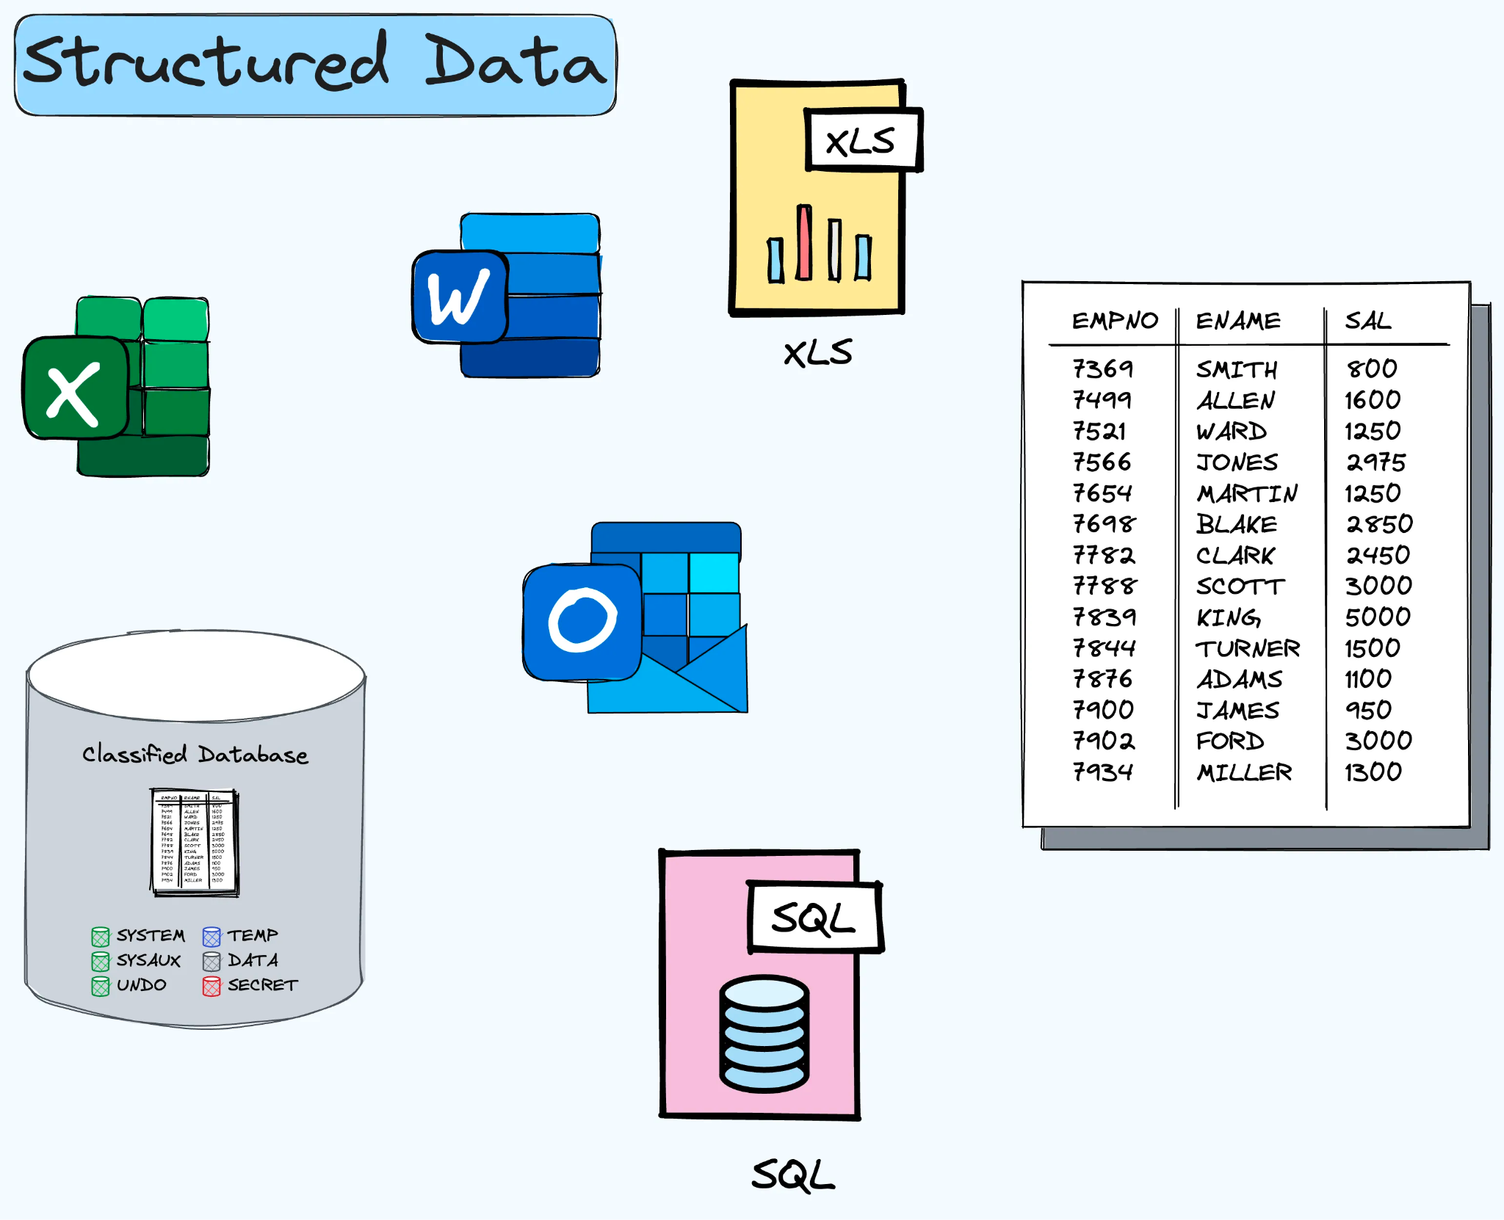
Structured Data

Slide 5
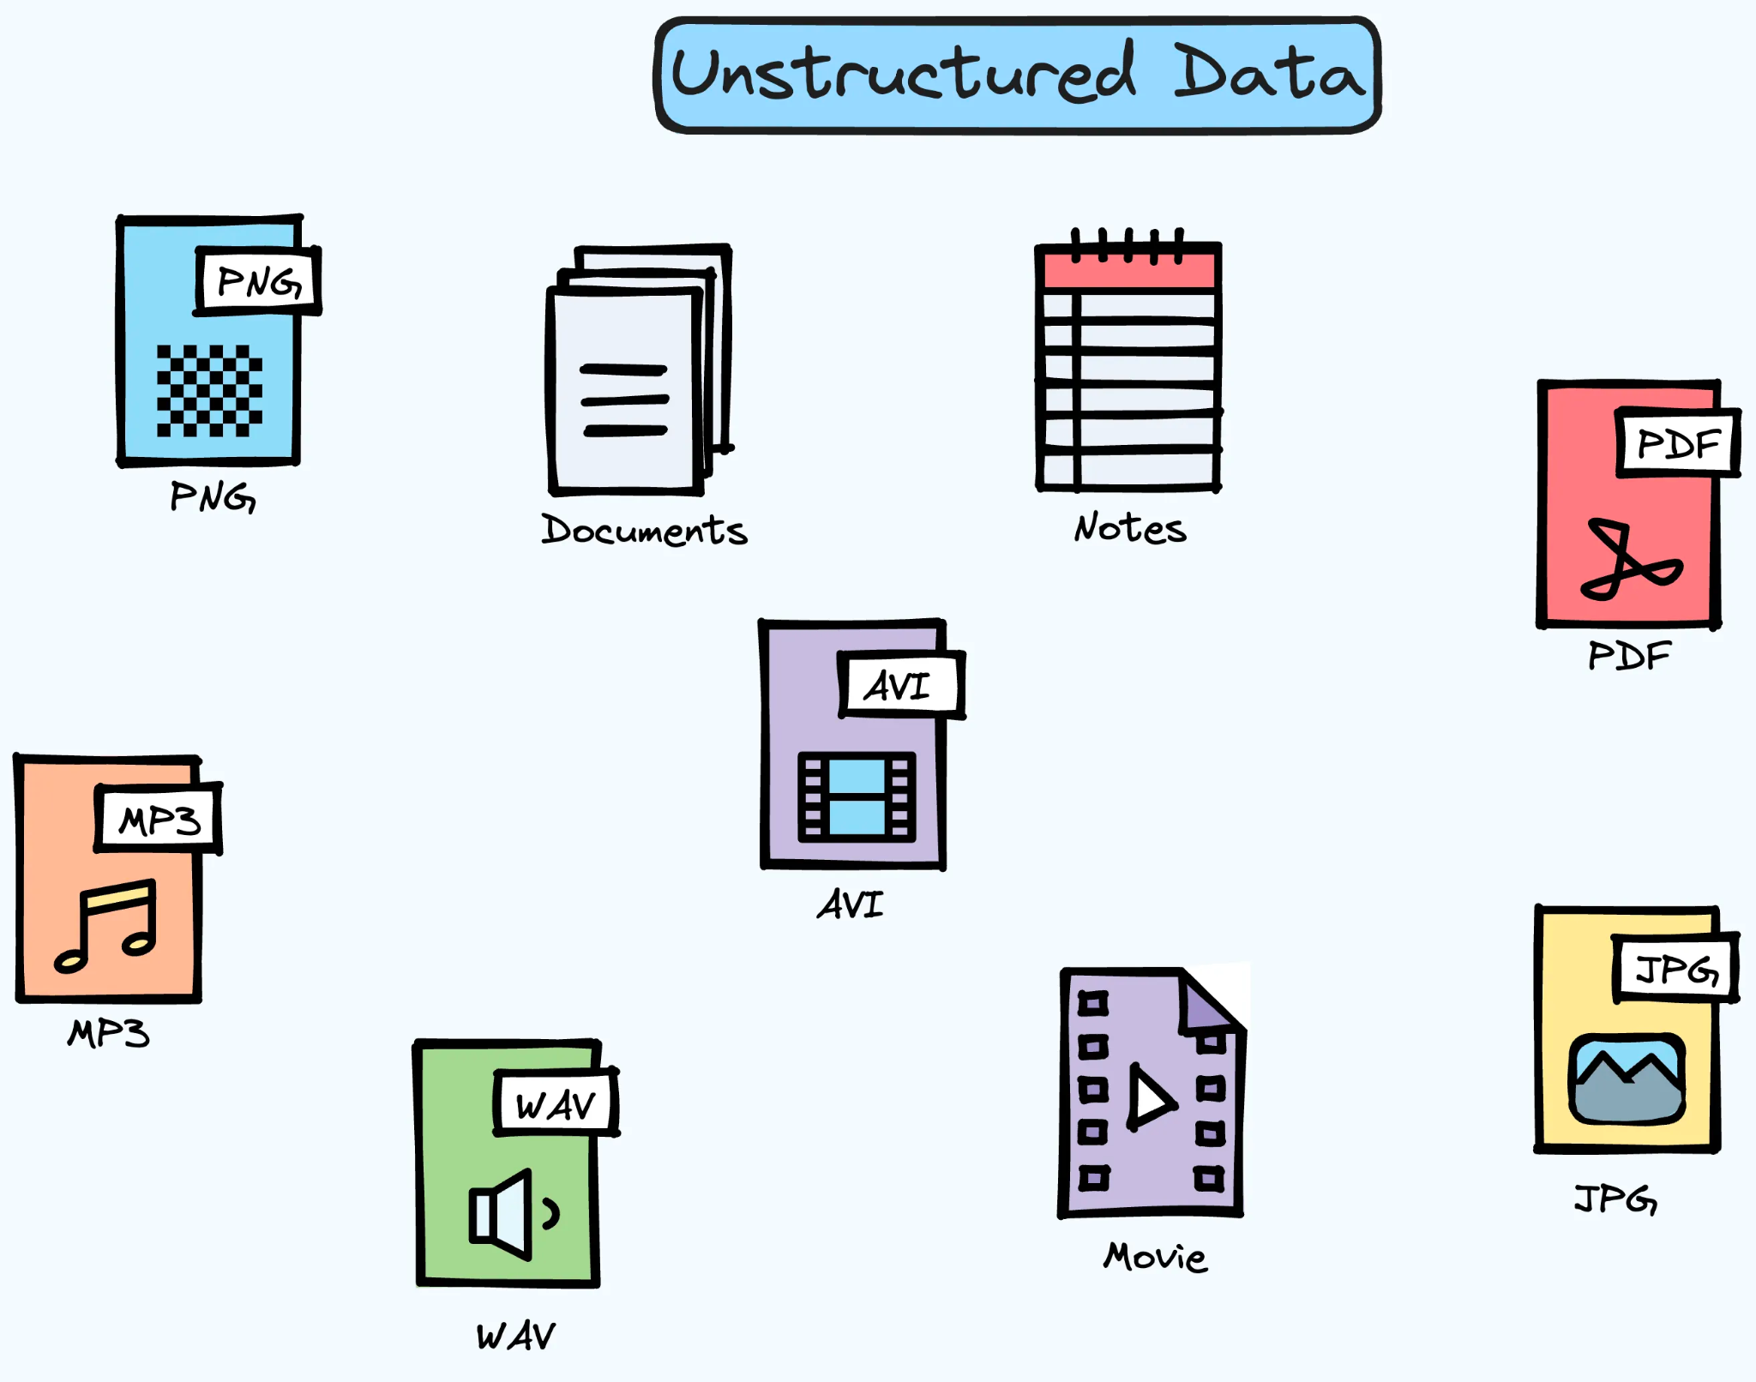
Data Lake

Slide 6
Unstructured Data
It does not have a pre-defined format or pre-defined schema.
It's called "unstructured" because it doesn't fit into tables or rows like structured data.
Some examples are text documents, emails, videos, audio files, social media posts, satellite images, etc.
Unstructured data accounts for more than 80% of all data and is part of the big data. Source: IDC estimates & Gartner.
It is stored in data lakes, object storage, or specialized databases like NoSQL, time-series, or vector databases

Slide 7
Benefits of a Data Lake:
Variety of Data: You can store any type of data, whether it's structured (like databases) or unstructured (like videos).
Scale: It's built to store a lot of data, and can expand easily.
Flexibility: You don't need to know exactly how you'll use the data when you store it. You can decide later and then process and analyze it in different ways.
Cost-effective: It's usually cheaper to store large amounts of raw data in a data lake compared to other storage solutions.

Slide 8
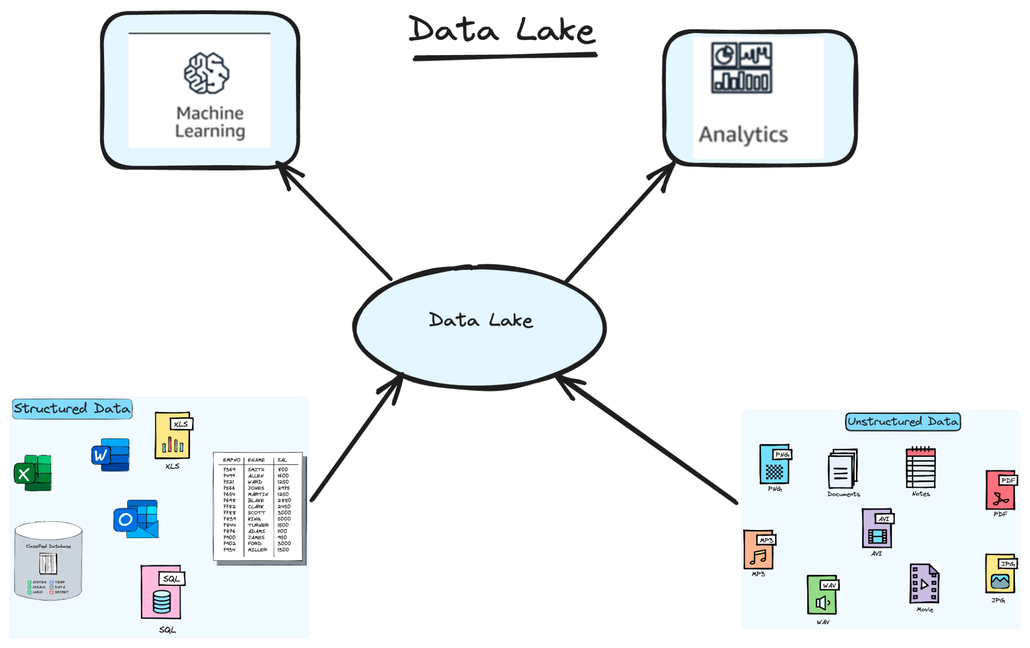
Data Lake

Slide 9
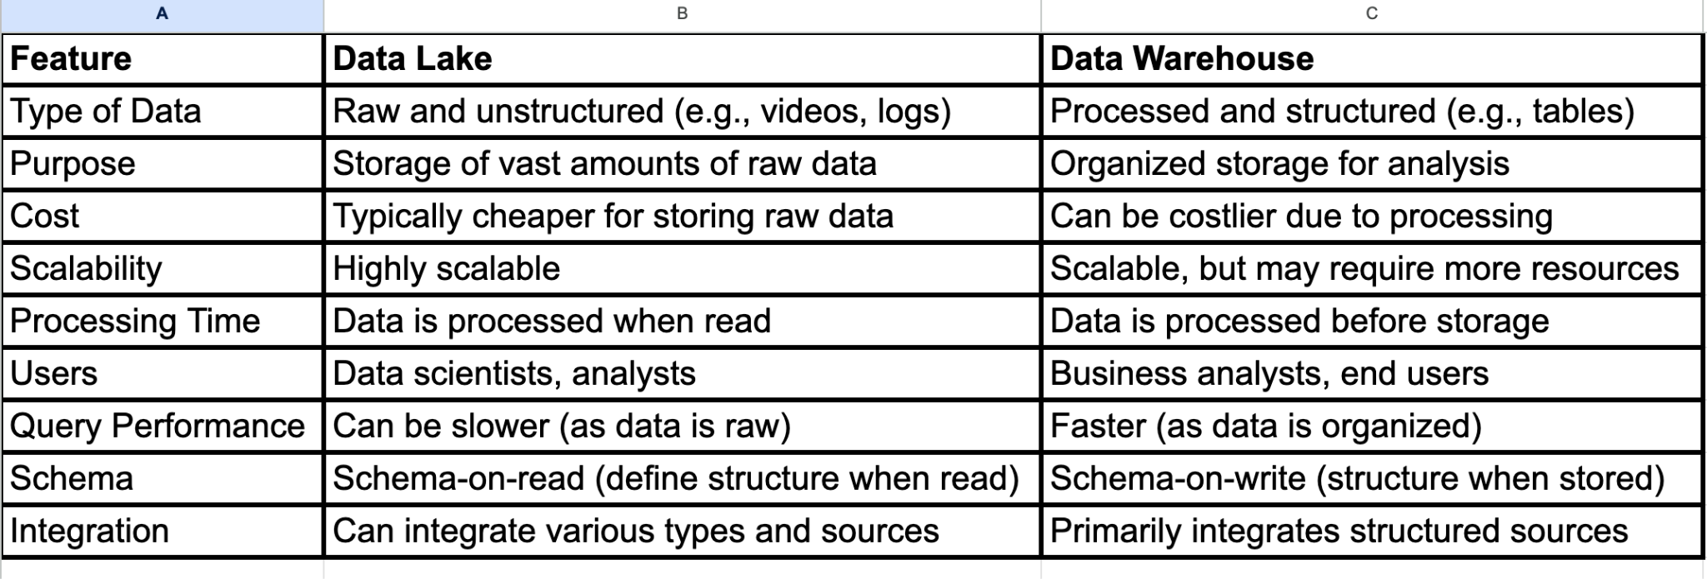
How is a Data Lake different from a Data Warehouse?

Slide 10
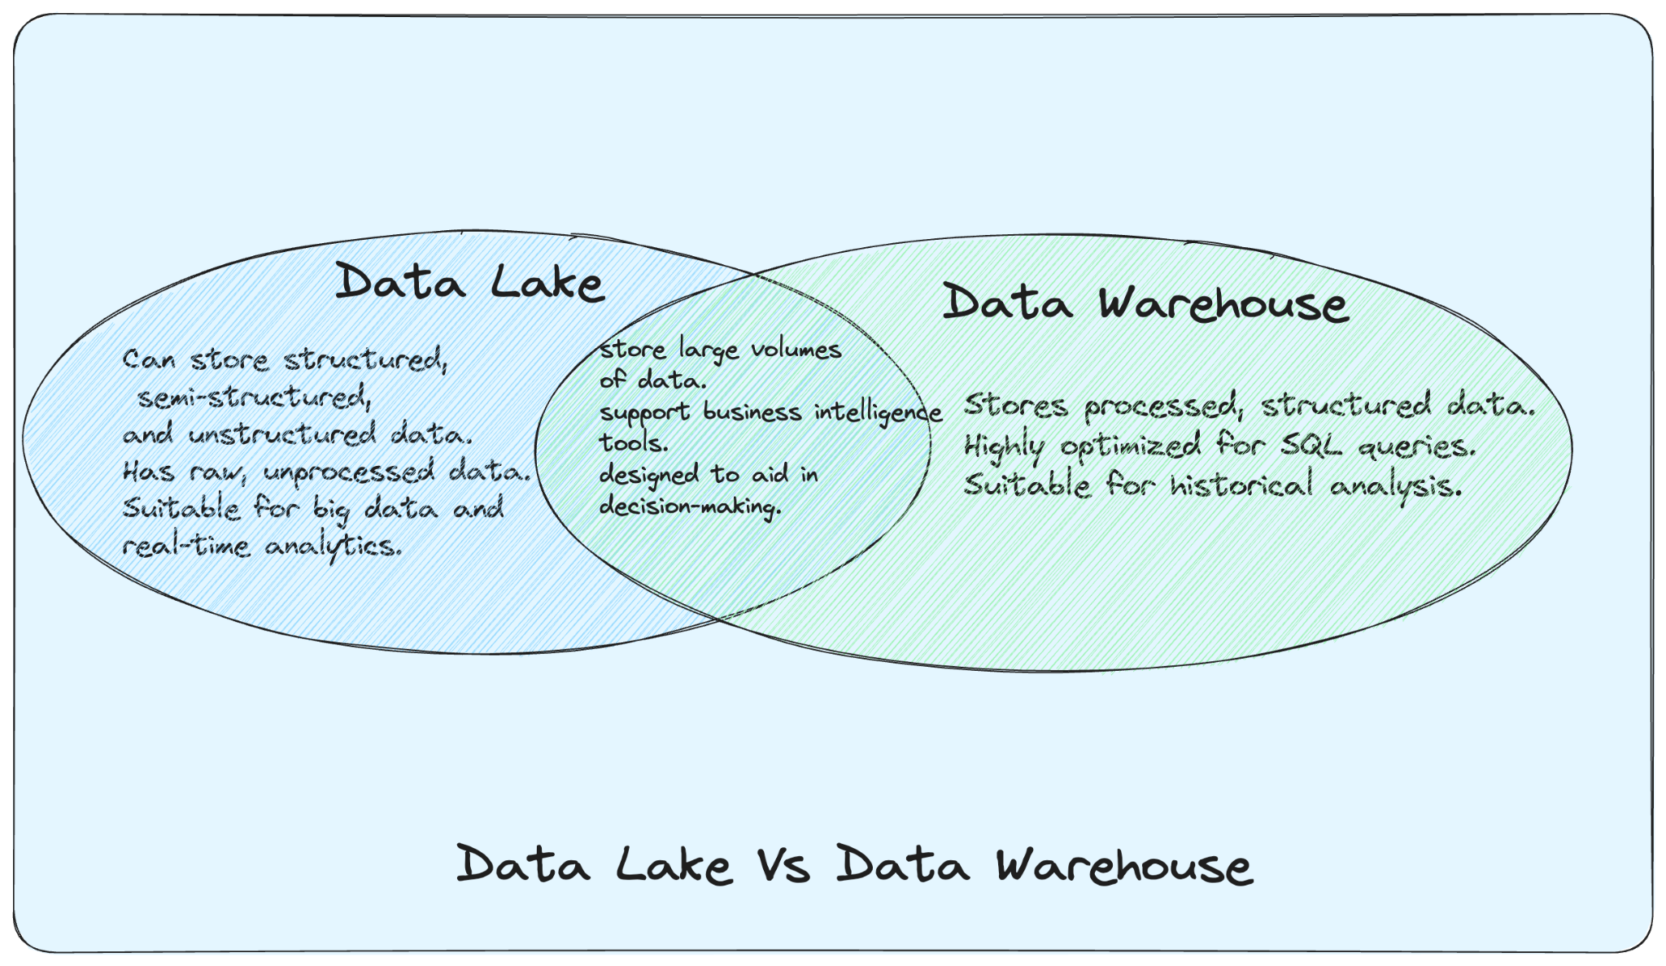

Slide 11
Benefits to the Client:
Future Proof: Since clients can store all kinds of data without worrying about structure, they're prepared for future needs. They won't regret not saving something important.
Insights and Discovery: With all their data in one place, they can use tools to discover new patterns and insights.
Flexibility: If clients want to test out new ways of analyzing data, they have all their raw data ready to play with in the Data Lake.
Cost Savings: It can be cheaper to store and manage large amounts of data in a data lake compared to other systems

Slide 12
What is Serverless Architecture?
Serverless architecture is a design pattern where the management of servers and infrastructure is handled by cloud providers. Instead of thinking about server maintenance, scaling, or capacity, you just focus on your code. When you run your code, the cloud provider automatically allocates the resources, and when the code completes, those resources are released.
Example: AWS Lambda

Slide 13
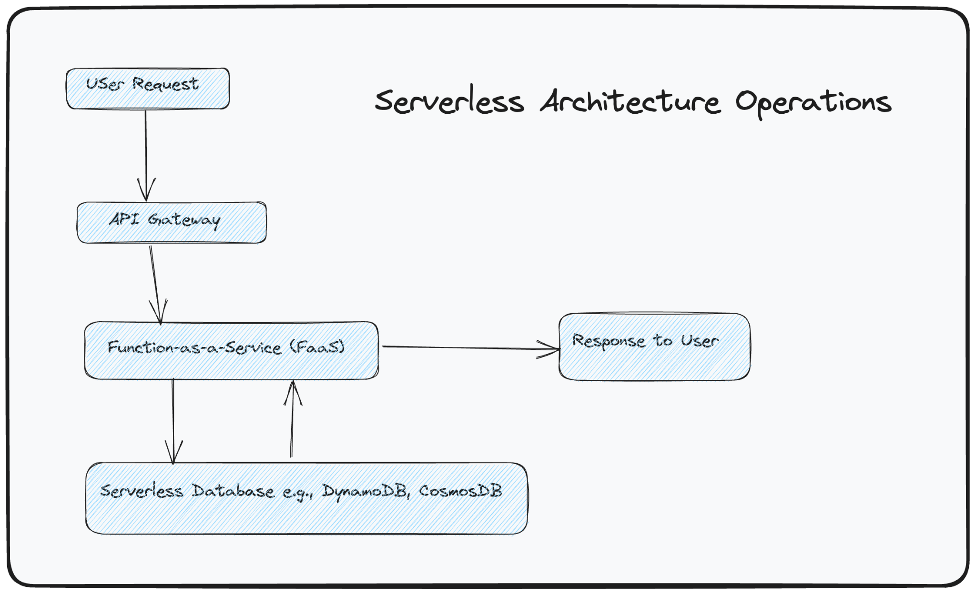

Slide 14
When Serverless
Serverless is an excellent option for projects that want to move quickly without worrying about infrastructure, especially for sporadic or unpredictable workloads.However, it comes with trade-offs.
AWS→ Lambda, Step Functions, Dynamo DB
GCP→ Cloud Functions, Cloud run, etc
Azure → Functions, Logic apps, etc

Slide 15
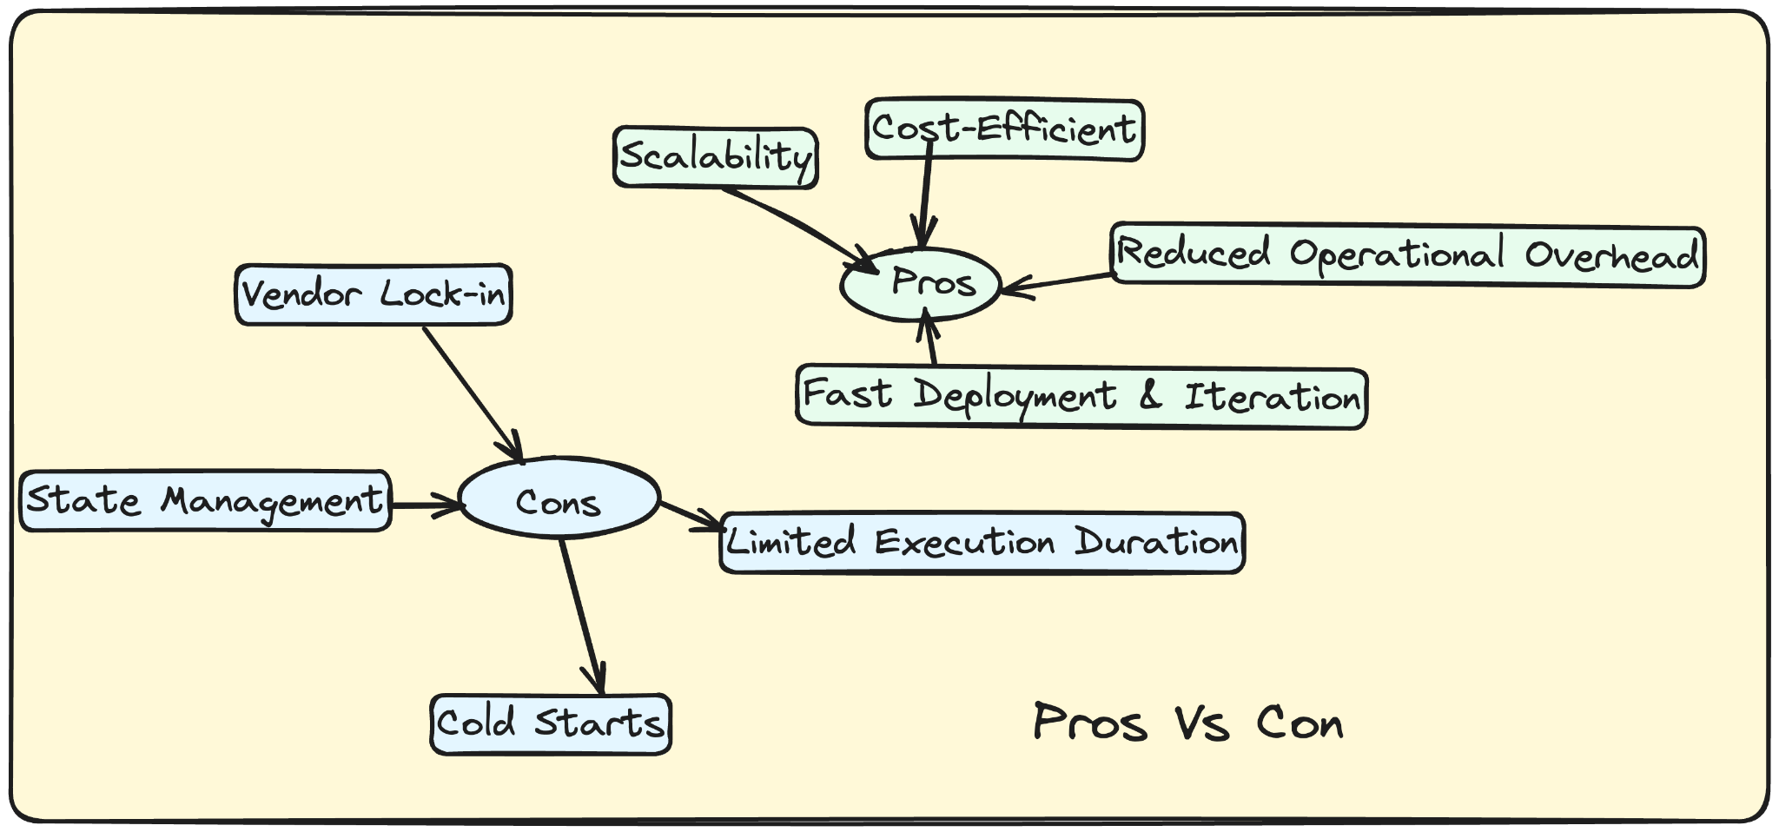

Slide 16
Pros of Serverless Architecture:
No Server Management: You don’t need to provision, scale, or maintain servers.
Cost Effective: You only pay for the compute time your code runs, not for idle server time.
Automatic Scaling: It scales automatically with the number of requests, without manual intervention.
Quick Deployments & Updates: Simplified deployment process often results in faster development cycles.
High Availability: Cloud providers ensure that the infrastructure is fault-tolerant and highly available.

Slide 17
Cons of Serverless Architecture:
Cold Starts: The first time a function runs (or after it hasn't been run for a while), it can have an added delay called a "cold start".
Limited Customization: There might be restrictions on runtime, memory, execution duration, etc.
State Management: Serverless functions are stateless, meaning managing and storing state can be challenging.
Debugging & Monitoring: Traditional debugging tools might not work in a serverless environment.
Vendor Lock-in: Relying heavily on a cloud provider’s implementation of serverless can make it hard to switch providers later.
Cost : If not monitored properly, a sudden surge in requests might lead to unexpected costs.

Slide 18
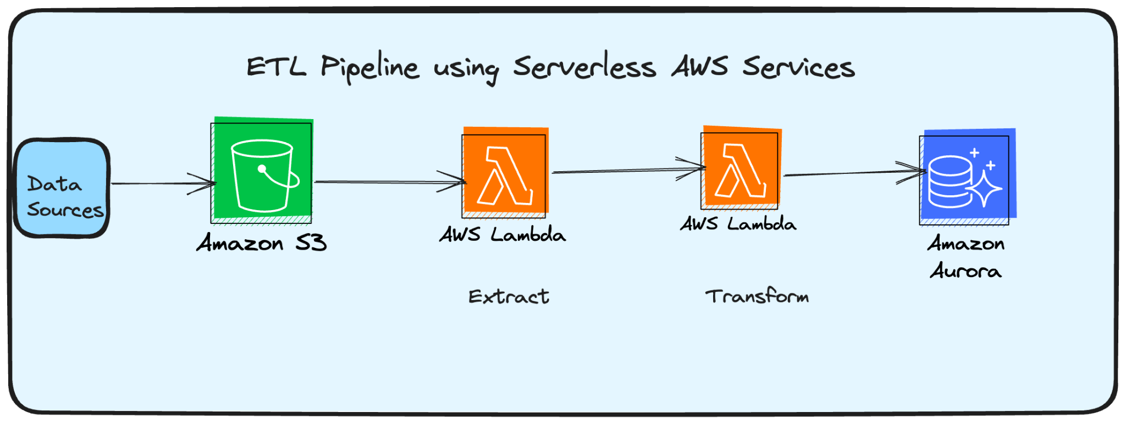
Diagram of ETL Pipeline using Serverless AWS Services

Slide 19
Pipeline
Data Sources:
This can be anything from web traffic logs, databases, third-party APIs, to IoT sensors.
Amazon S3:
Serves as the primary landing zone for raw data.
It's durable and cost-effective for storing large amounts of unstructured or structured data.
Data from various sources is ingested into S3.
Once new data is dumped into S3, it can trigger a Lambda function for further processing.

Slide 20
Pipeline-Continued
Event Trigger:
Notify when new data arrives.
AWS Lambda can be set up to automatically execute code in response to notifications from Amazon S3 (like when a new file is saved).
Amazon Lambda (Extract):
Serverless compute service that can run code in response to certain events without requiring any infrastructure management.
After being triggered by the new data in S3, this Lambda function will extract the relevant information from the raw data.

Slide 21
Pipeline-Continued
Amazon Lambda (Transform):
Another Lambda function in the pipeline that's responsible for the transformation phase.
Transforms the extracted data (cleaning, enrichment, aggregating, filtering, etc.) into a format suitable for analytics or loading to the destination database.
Amazon RDS/Aurora/Redshift (Load):
These are managed relational database services from AWS. Redshift, specifically, is designed for OLAP (Online Analytical Processing) and can handle large scale data warehousing.
The transformed data from the Lambda function is then loaded into one of these databases for analytics or reporting.Here we have Aurora

Slide 22
MLOps
MLOps is a set of practices and tools that unifies machine learning system development and operations (Ops).
It aims to automate and streamline the end-to-end machine learning lifecycle, from data preparation and model training to deployment and monitoring, ensuring faster, more reliable, and continuous delivery of ML models to production.

Slide 23
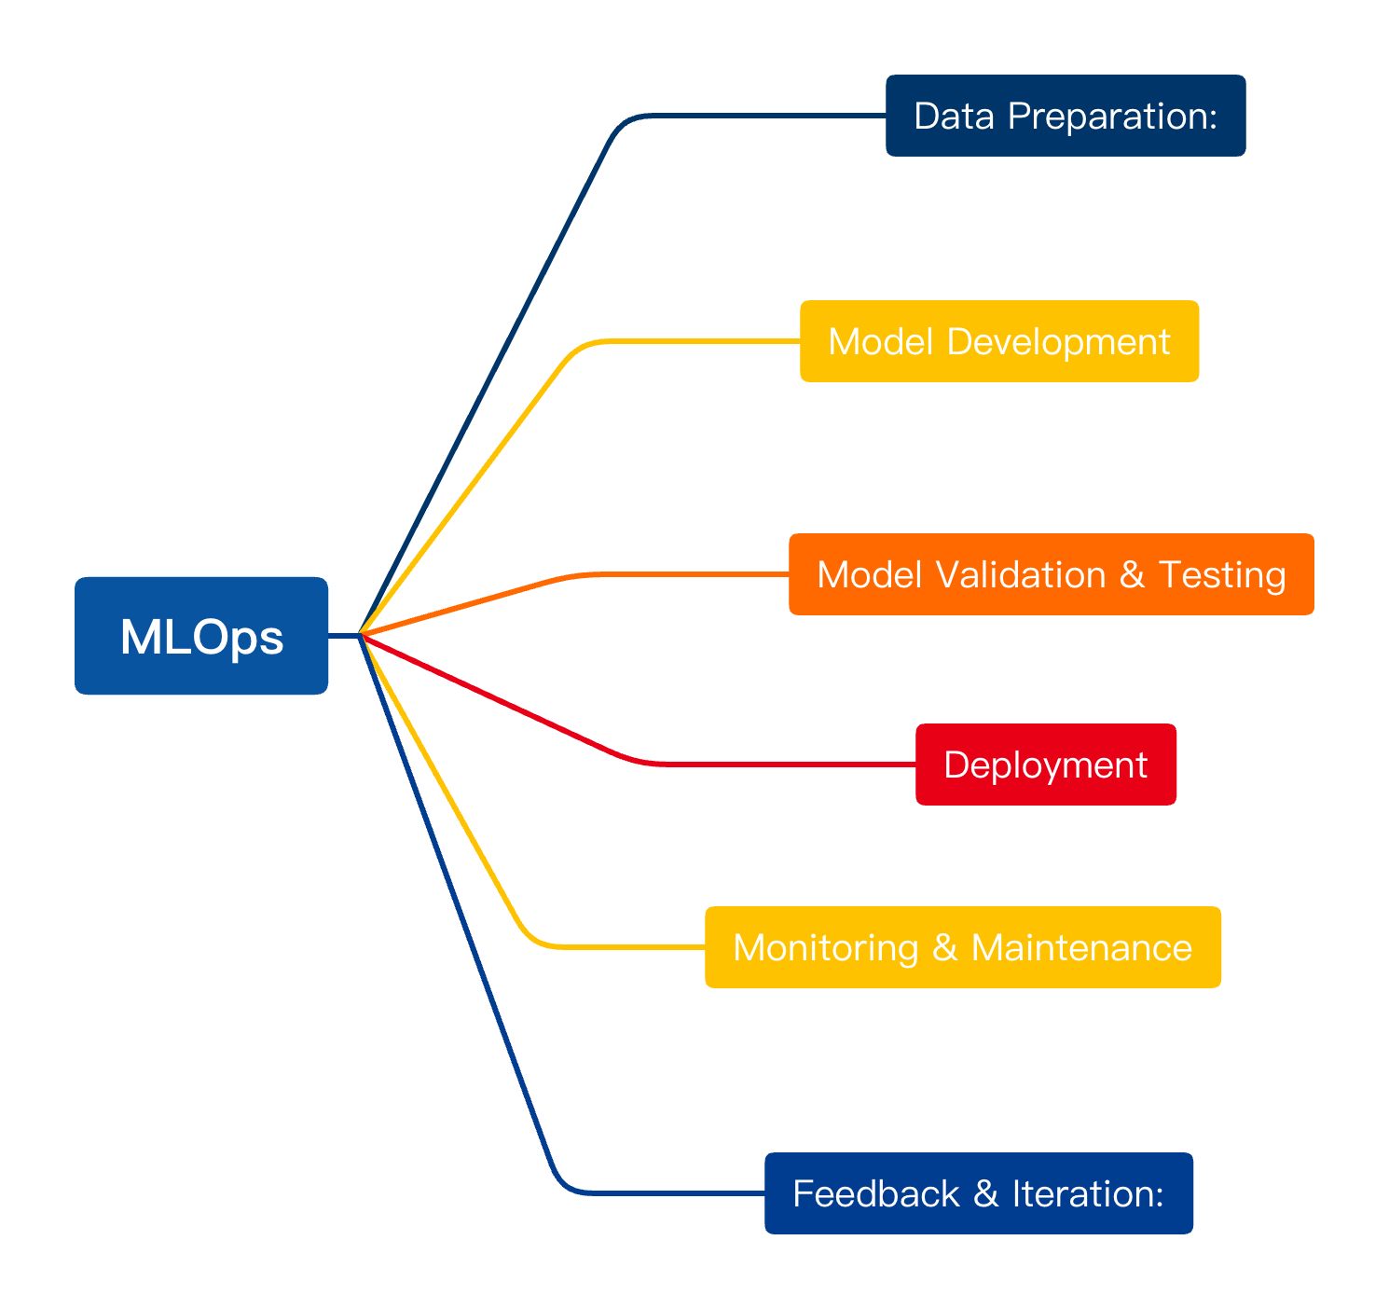

Slide 24
Key principles of MLOps include:
Versioning: Everything from raw data, processed datasets, feature engineering scripts, to models should be versioned, ensuring reproducibility.
Automated Testing: Before deploying, models should be tested for their performance, robustness, and fairness.
Continuous Integration and Continuous Delivery (CI/CD) for ML: Automate the building, testing, and deployment processes for ML models, similar to software deployment.
Monitoring and Logging: Continuous monitoring of model performance in production, detecting data drift, model decay, and logging predictions for audit purposes.
Model Governance and Auditability: Ensuring that models meet regulatory requirements, have proper documentation, and can be audited.
Collaboration and Communication: Promote a seamless collaboration environment where data scientists, ML engineers, and operations can work together effectively.

Slide 25
MLOps and how organizations should approach it from a tools and systems perspective:
Data Versioning Tools: Tools like DVC (Data Version Control) help in versioning datasets and ML models similar to how Git versions code.
Pipeline Orchestration: Tools like Apache Airflow or Prefect can be used to automate ML workflows, ensuring that processes like data collection, preprocessing, and model training happen in a structured manner.
Experiment Tracking: Use tools like MLflow or TensorBoard to track and compare different model experiments.
Automated Deployment: Platforms like TFX (TensorFlow Extended) or tools like Seldon or Kubeflow can help in the seamless deployment of ML models.

Slide 26
MLOps and how organizations should approach it from a tools and systems perspective:
Model Monitoring: Monitor models in production using tools like Prometheus, Grafana, or specialized solutions like ModelDB or Fiddler.
Containerization and Orchestration: Use Docker for containerizing ML models to ensure consistent environments. Kubernetes can be used to orchestrate these containers, ensuring scalability and reliability.
Infrastructure as Code (IaC): Use tools like Terraform or AWS CloudFormation to codify infrastructure requirements, making it easier to replicate ML environments.
Collaboration Tools: Platforms like Jupyter or tools like Git promote collaboration among team members, helping them share and review code, data, and models.

Slide 27
MLOps and how organizations should approach it from a tools and systems perspective:
Central Model Registry: Maintain a central repository of models, their versions, and metadata, facilitating rollbacks, audits, and compliance.
Feedback Loops: Set up systems to obtain feedback on model predictions, which can be used for active learning or model retraining.
Conclusion:It’s not just about tools but also culture. It requires a cultural shift, where ML development is seen through the lens of software engineering principles, and where collaboration and automation are prioritized. By integrating these tools and systems and fostering the right culture, organizations can achieve faster, more reliable, and more accountable ML deployments.

Slide 28
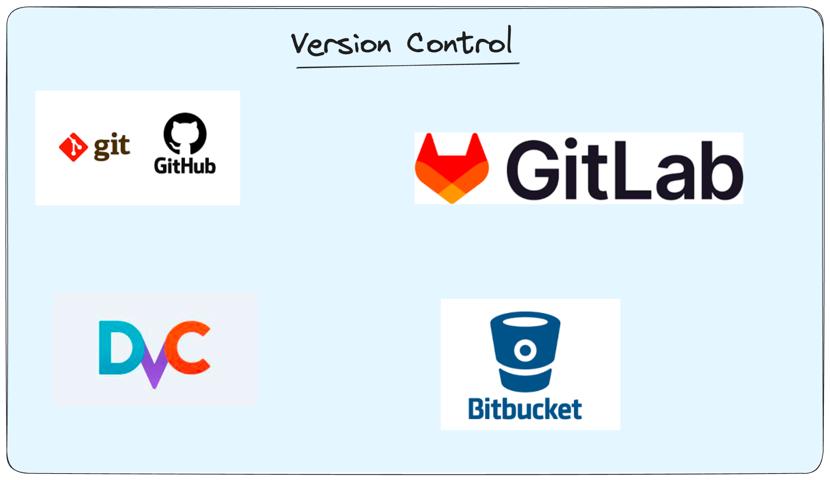

Slide 29
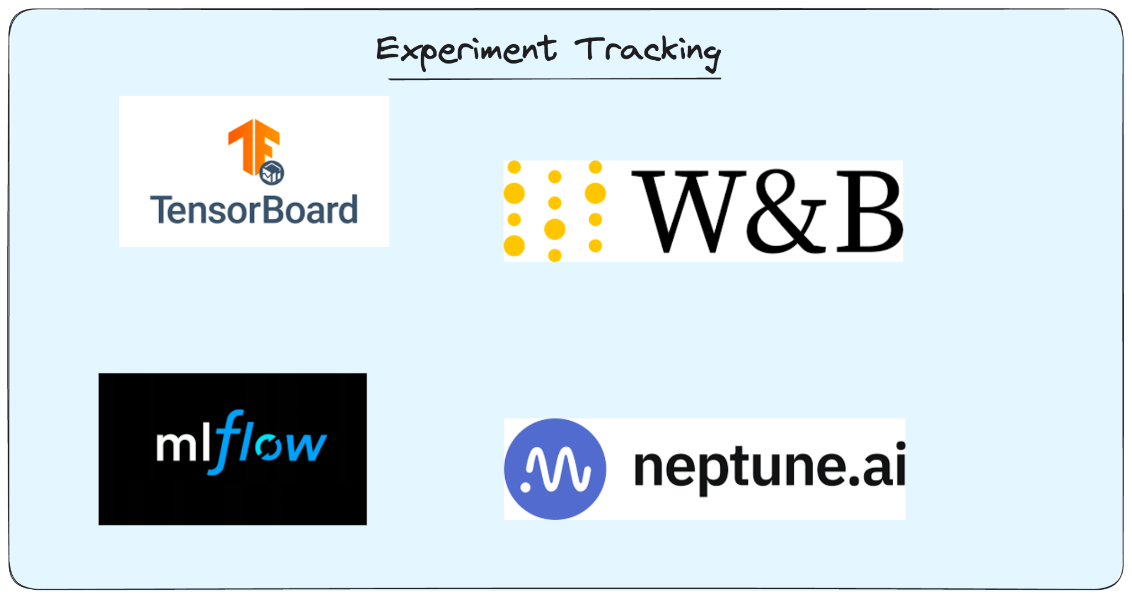

Slide 30
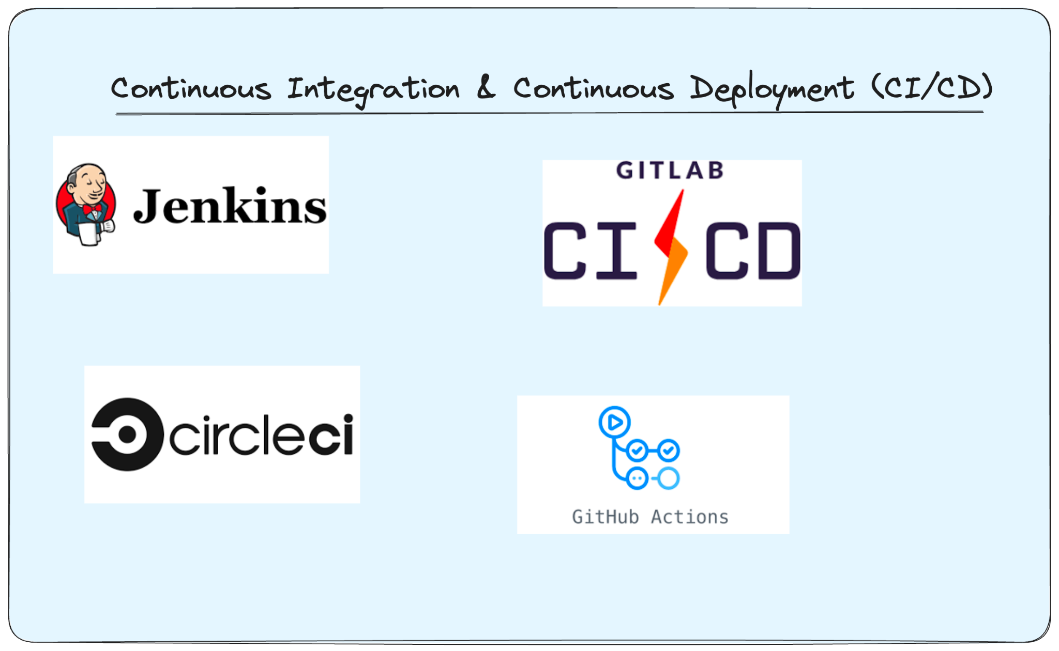

Slide 31
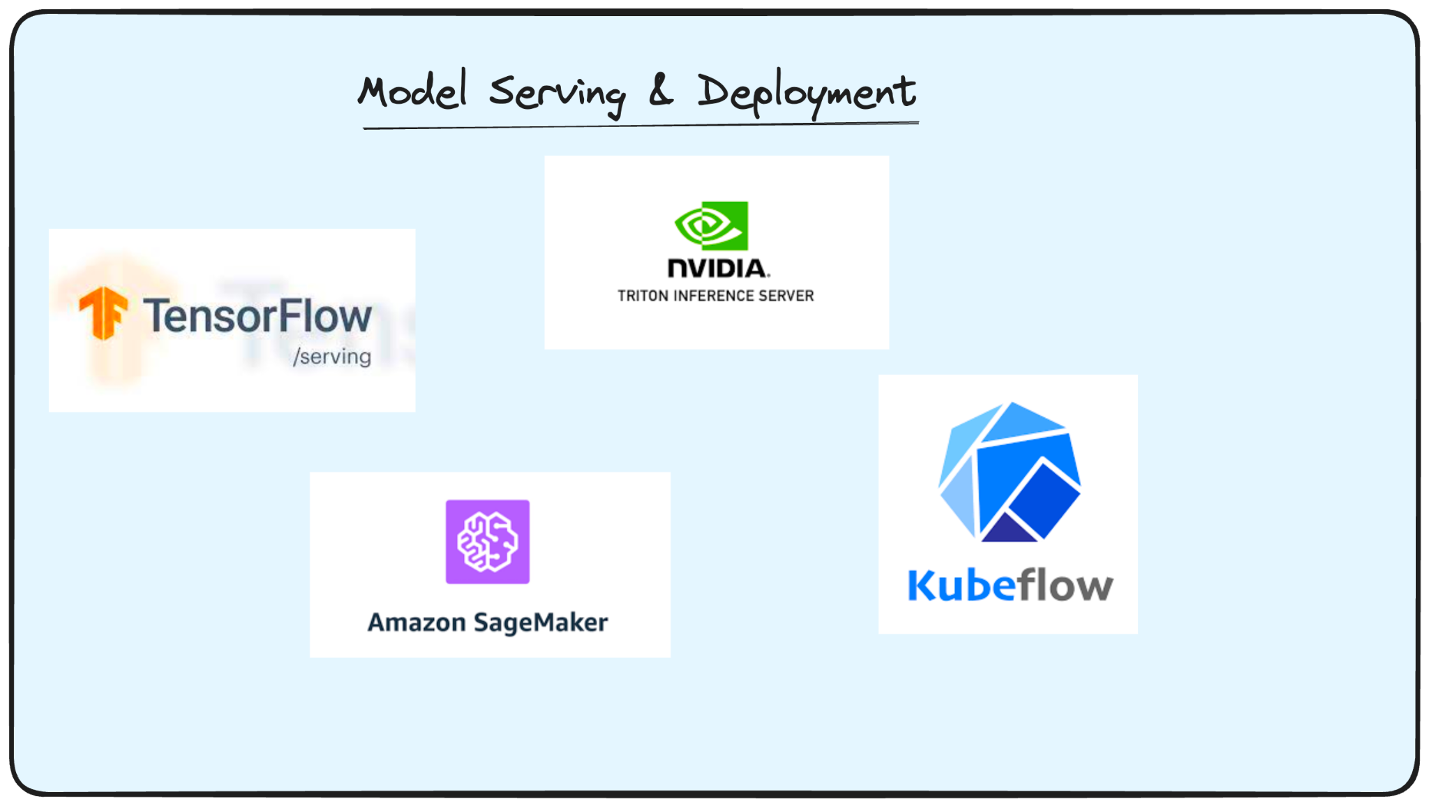

Slide 32
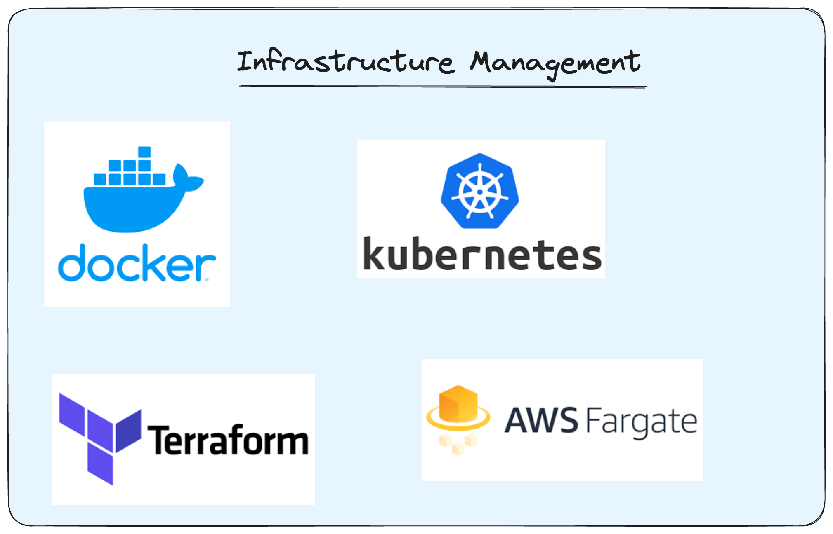

Slide 33
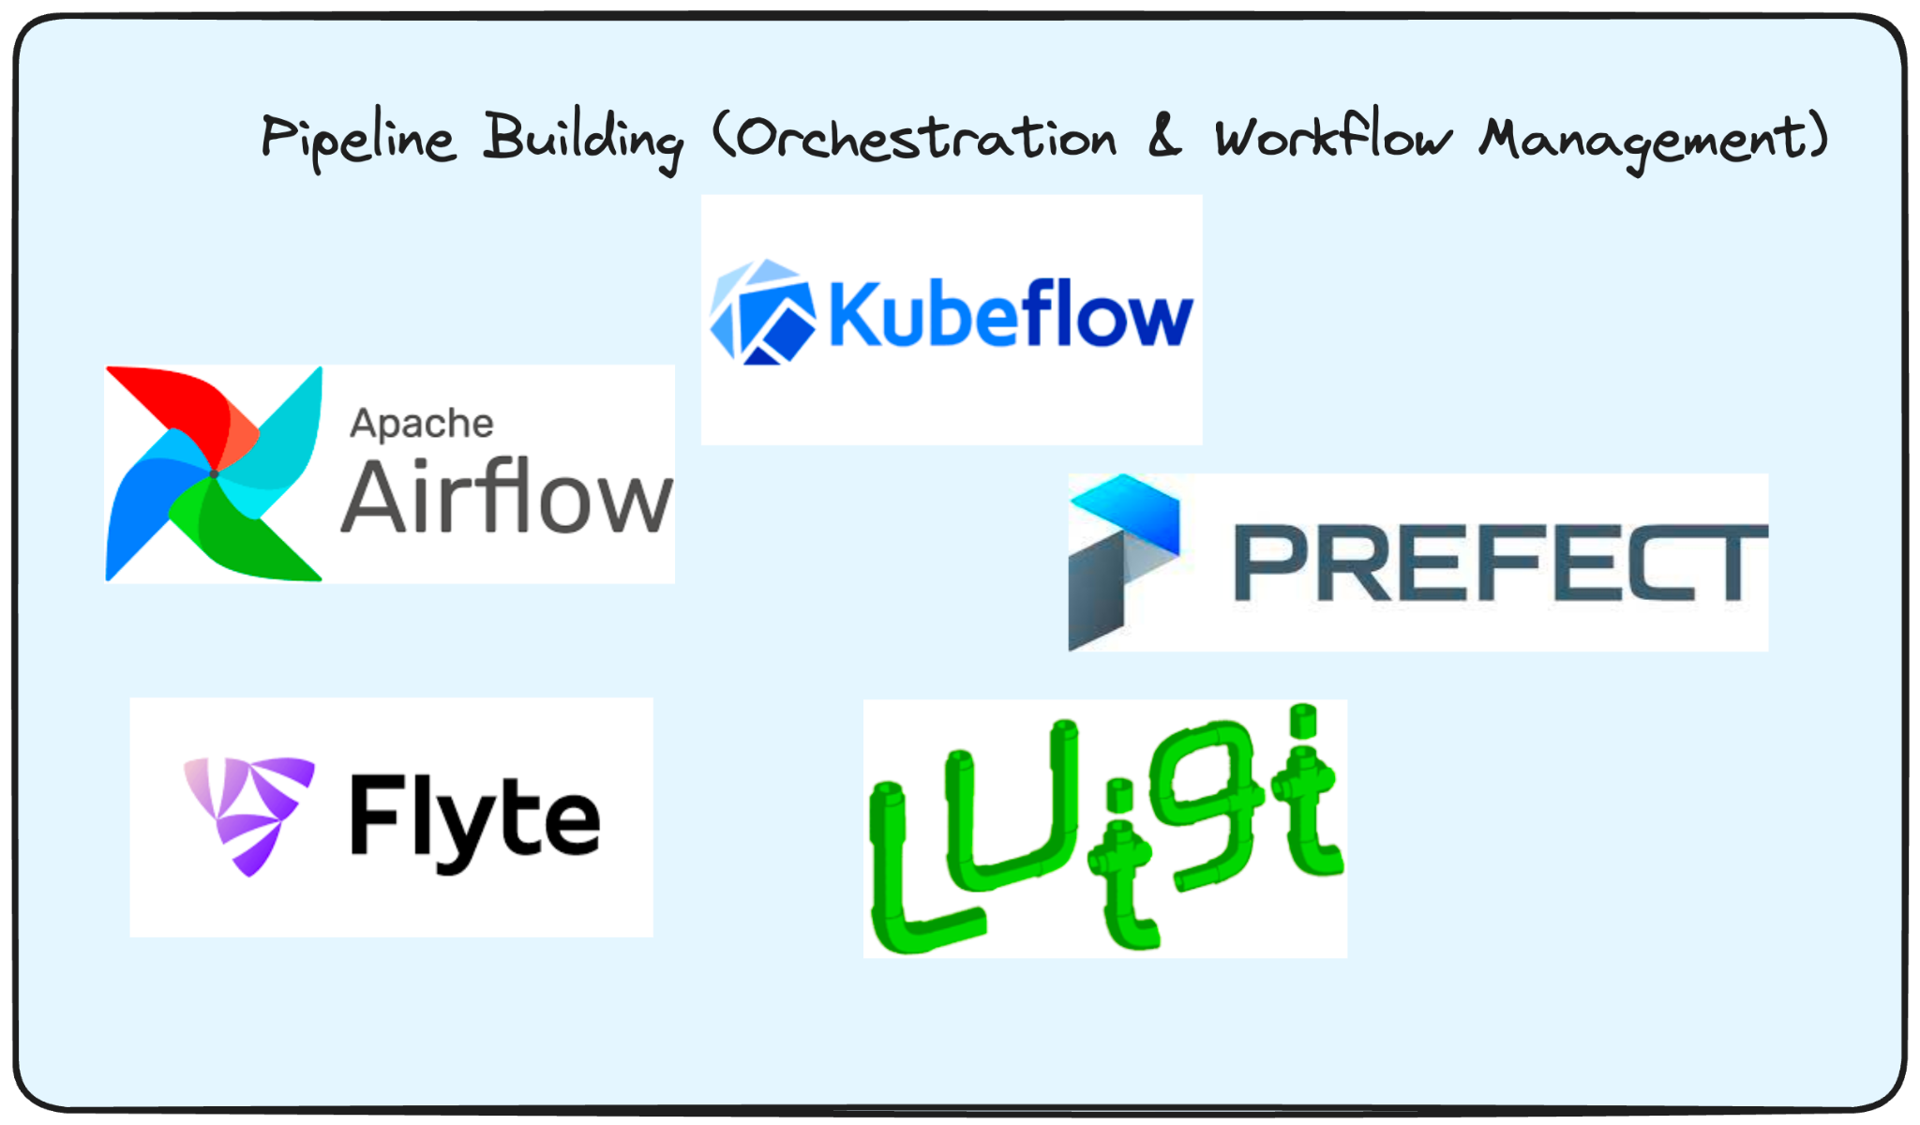

Slide 34
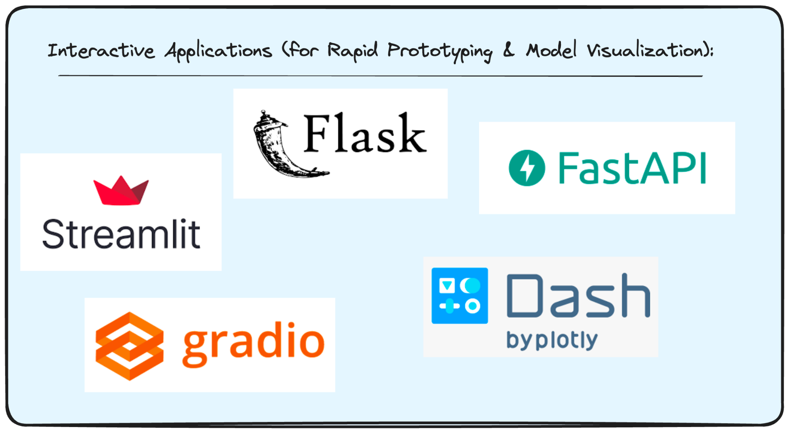

Slide 35
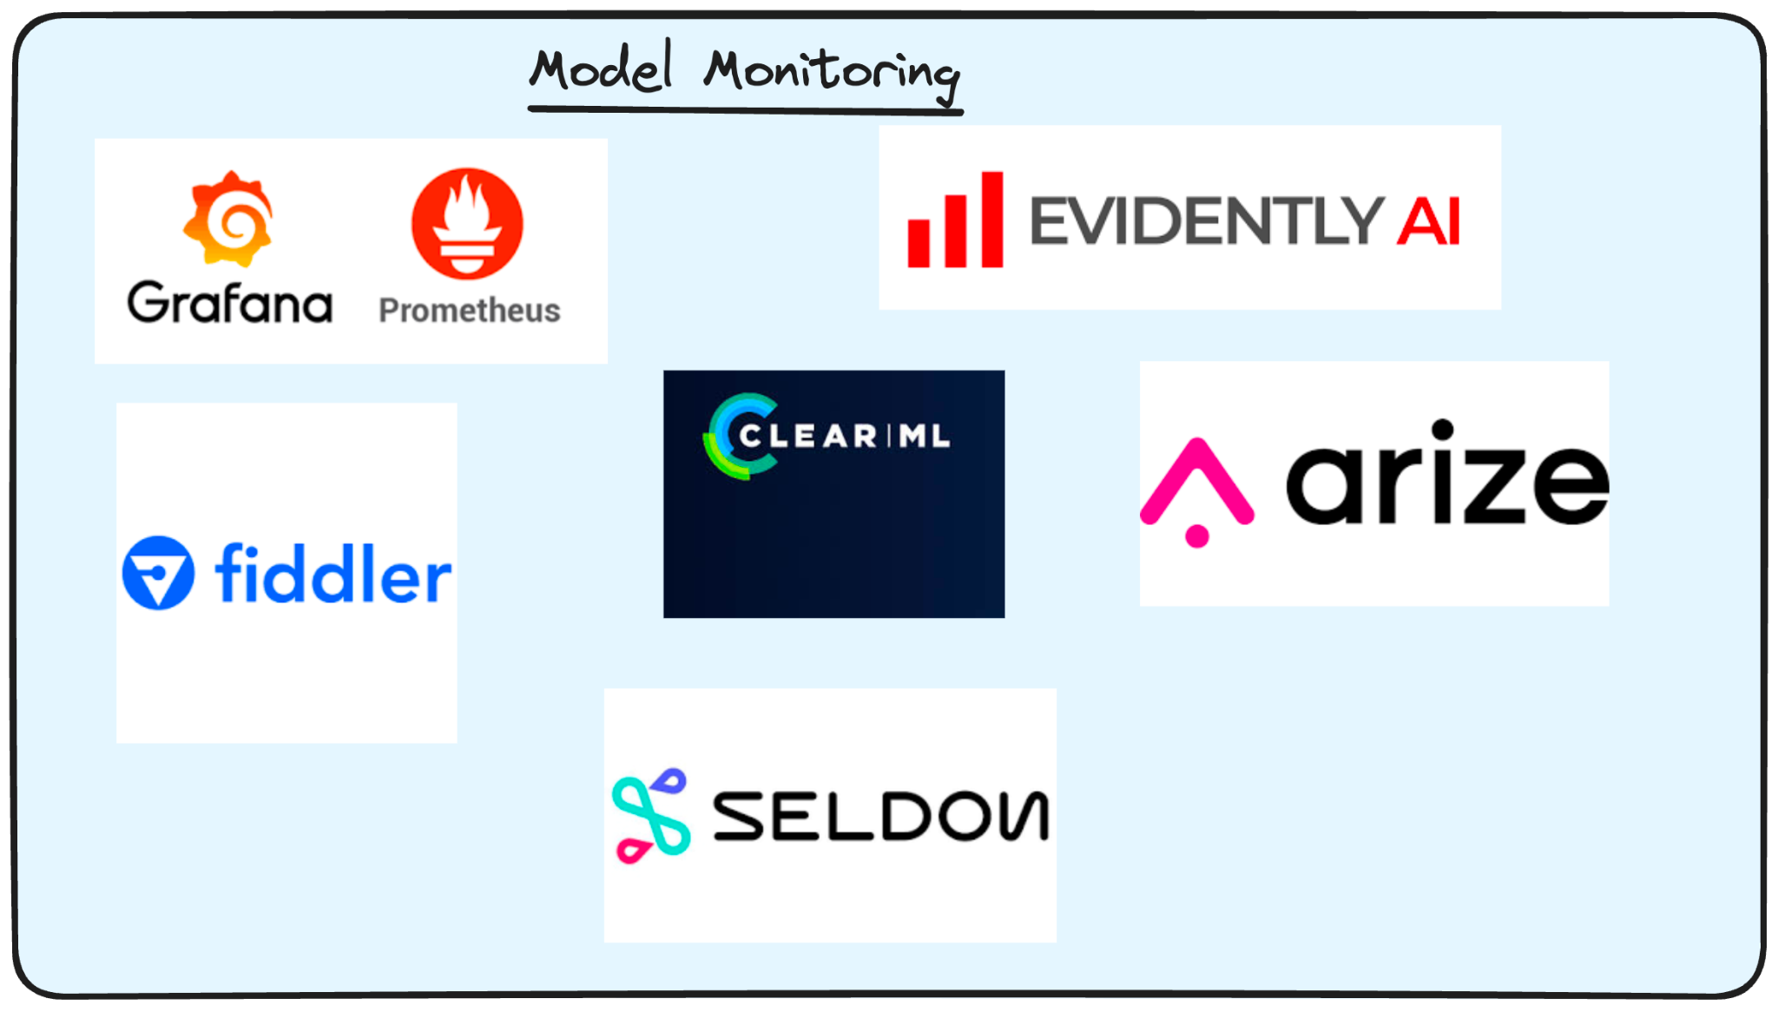

Slide 36
Section 2: Database & Python ETL
Selection of Database: SQLite
SQLite is a lightweight, serverless, and self-contained SQL database engine. It's great for local development and prototyping.
ETL:
Extract: Load the data from the provided Excel file.
Transform: Create one or two new fields and apply transformations where needed.
Load: Insert the transformed data into the SQLite database.

Slide 37
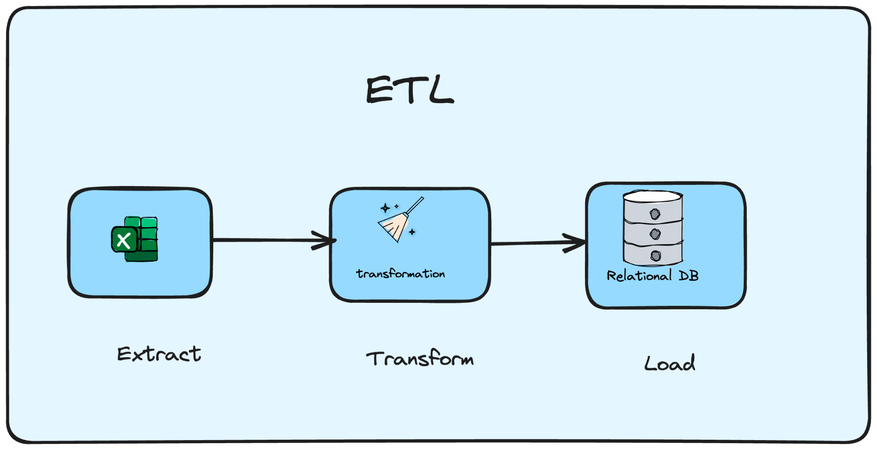

Slide 38
Examine the Dataset
The dataset contains the following columns:
id: A unique identifier for each entry.
first_name: First name of the person.
last_name: Last name of the person.
email: Email address of the person.
gender: Gender of the person.
ip_address: IP address associated with the person.

Slide 39
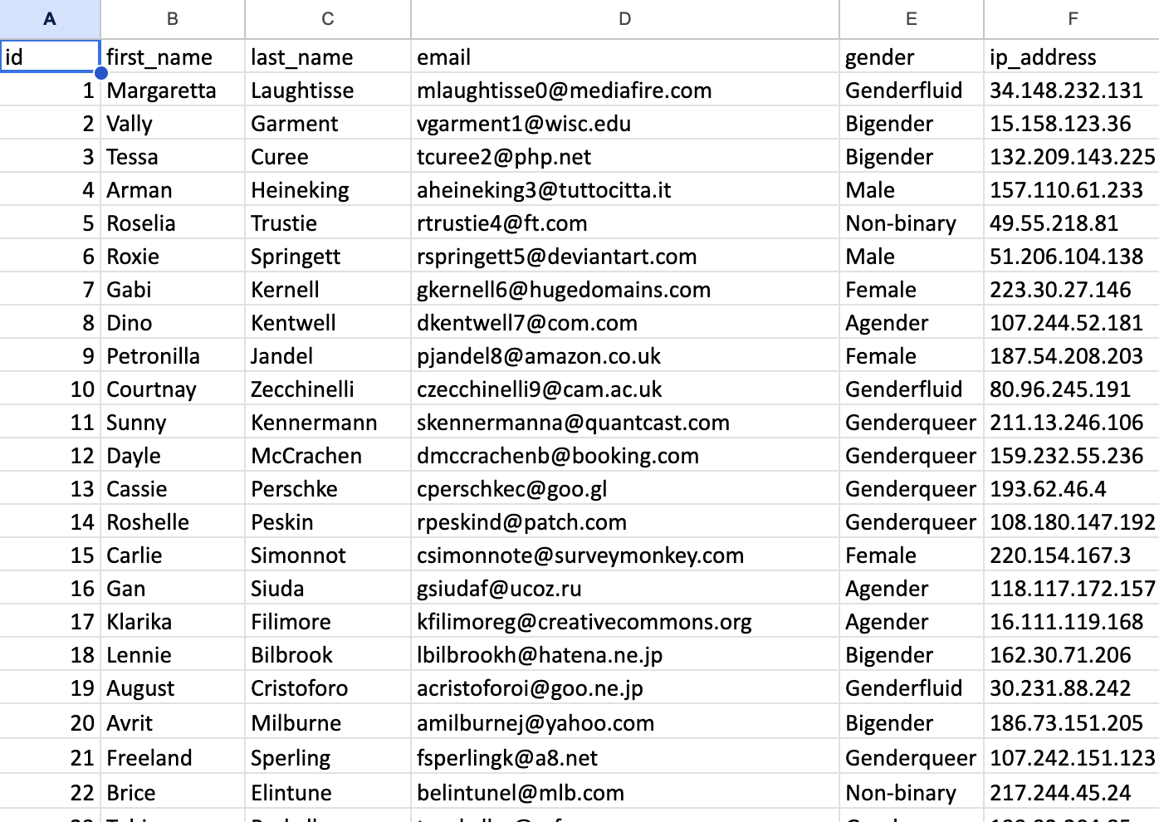

Slide 40
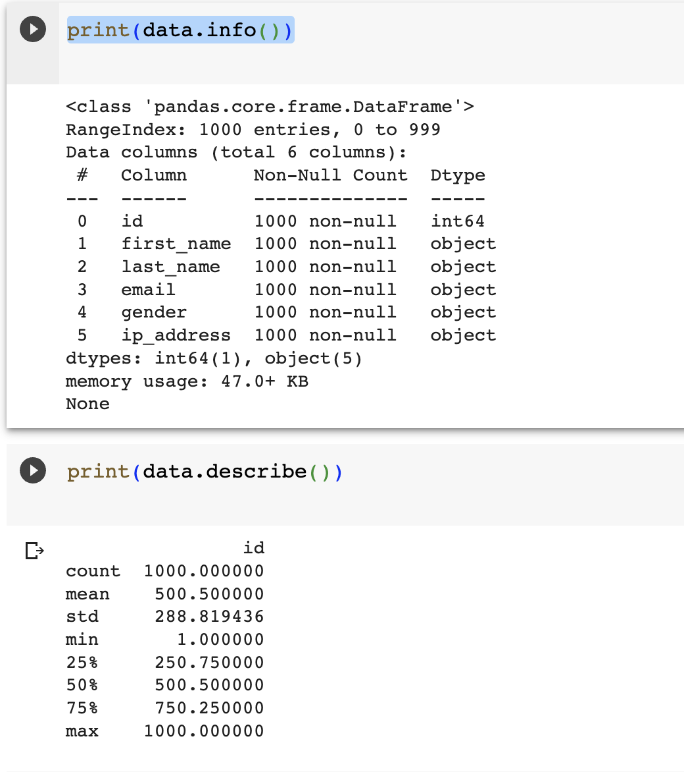
Basic Stats:

Slide 41
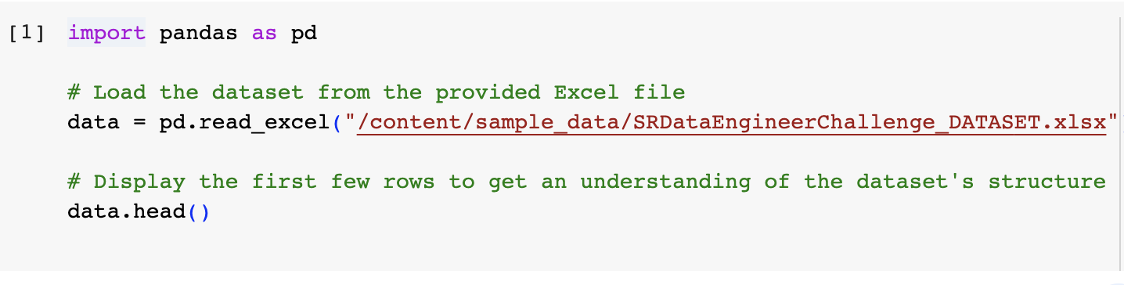
Walk through the Code
Extract: Read the data from the provided Excel file using pandas

Slide 42
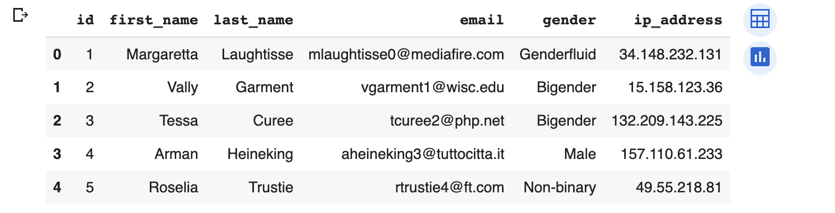
Extract
Display the dataframe and check few records

Slide 43
Transformations Applied
Full Name: We can combine the first_name and last_name columns to create a full_name column.
data['full_name'] = data['first_name'] + " " + data['last_name']
Domain of Email: We can extract the domain from the email column to understand which email service providers are most popular.
data['email_domain'] = data['email'].str.split('@').str[1]

Slide 44
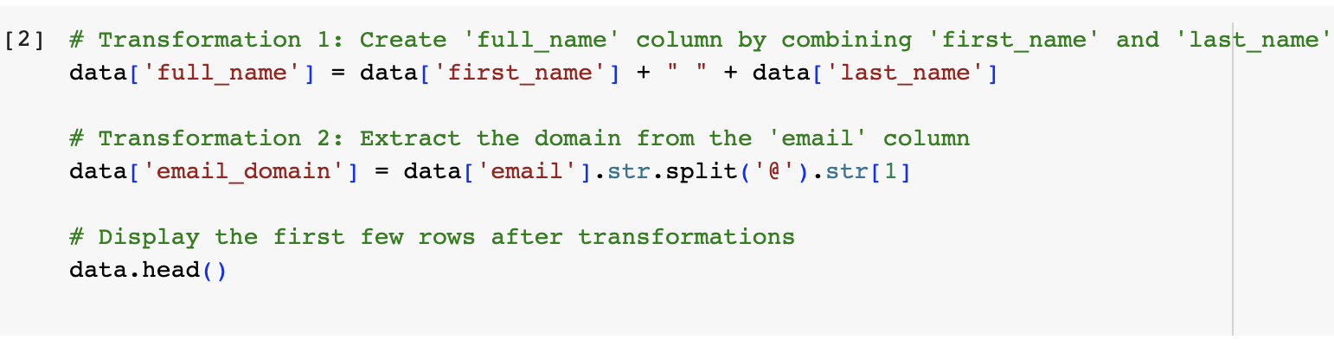
Transformations

Slide 45
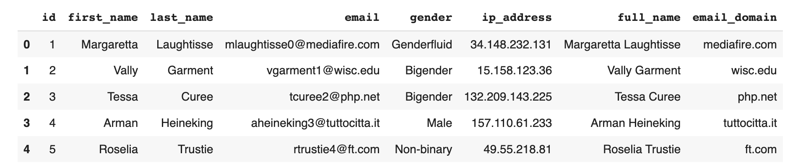
Transformations
Full Name and Email Domain are added

Slide 46
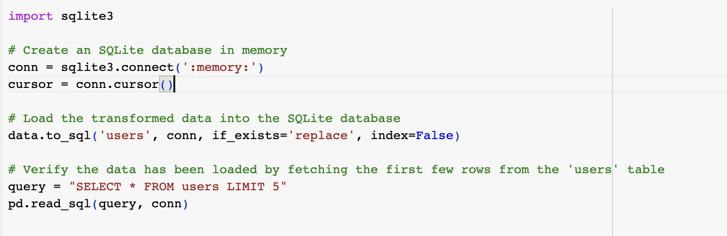
Load
Now load the transformed data into SQLite database table.

Slide 47
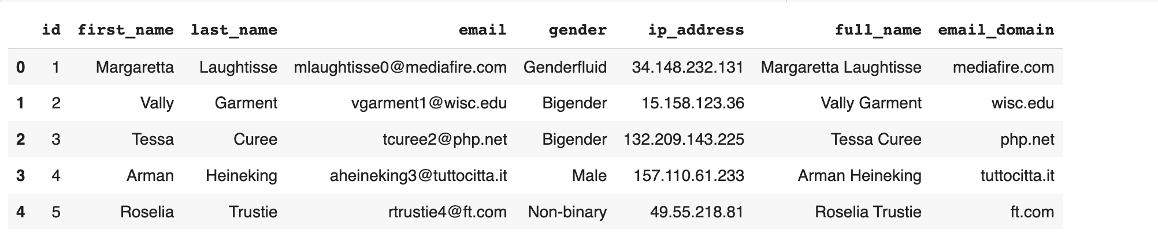
Load
Query the table and see the output

Slide 48
Load Data
SQLite3 Import:
The sqlite3 library is imported, which allows for interaction with SQLite databases in Python.
Database Creation:
An SQLite database is created in memory. This means the database is temporary and will be discarded once the connection is closed.
A cursor object (cursor) is created, which will be used to execute SQL commands.
Data Loading:
The DataFrame data is loaded into the SQLite database.
A new table named users is created in the database to hold this data.
If a table named users already exists, it will be replaced with the new data. This is due to the if_exists='replace' parameter.
The index=False parameter ensures that the DataFrame's index is not saved as a separate column in the database.
Data Verification:
A SQL query is constructed to fetch the first five rows from the users table.
The pd.read_sql function is used to execute this query, and the result is returned as a DataFrame.

Slide 49
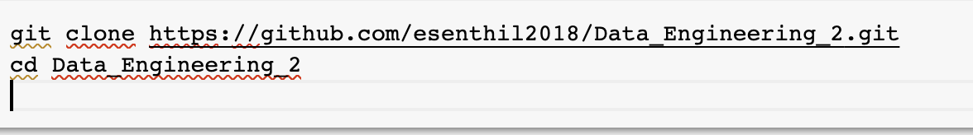
Replicate
1.Clone the Repository:
First, clone the GitHub repository containing the ETL script and associated files.

Slide 50
Replicate
2.Docker File:
# Use an official Python runtime as the base image
FROM python:3.9-slim
# Set the working directory in the container to /app
WORKDIR /app
# Copy the current directory contents into the container at /app
COPY . /app
# Install required packages
RUN pip install --no-cache-dir -r requirements.txt
# Run the ETL script when the container is started
CMD ["python", "etl_script.py"]

Slide 51
Replicate
3.requirements.txt
pandas
sqlite3
openpyxl

Slide 52
Replicate
Build and run:
docker build -t etl-image .
docker run etl-image
Once the container is running, the ETL script (etl_script.py) will automatically start processing the data. The script will extract data from the provided dataset, perform transformations, and load it into an SQLite database in memory.

Slide 53
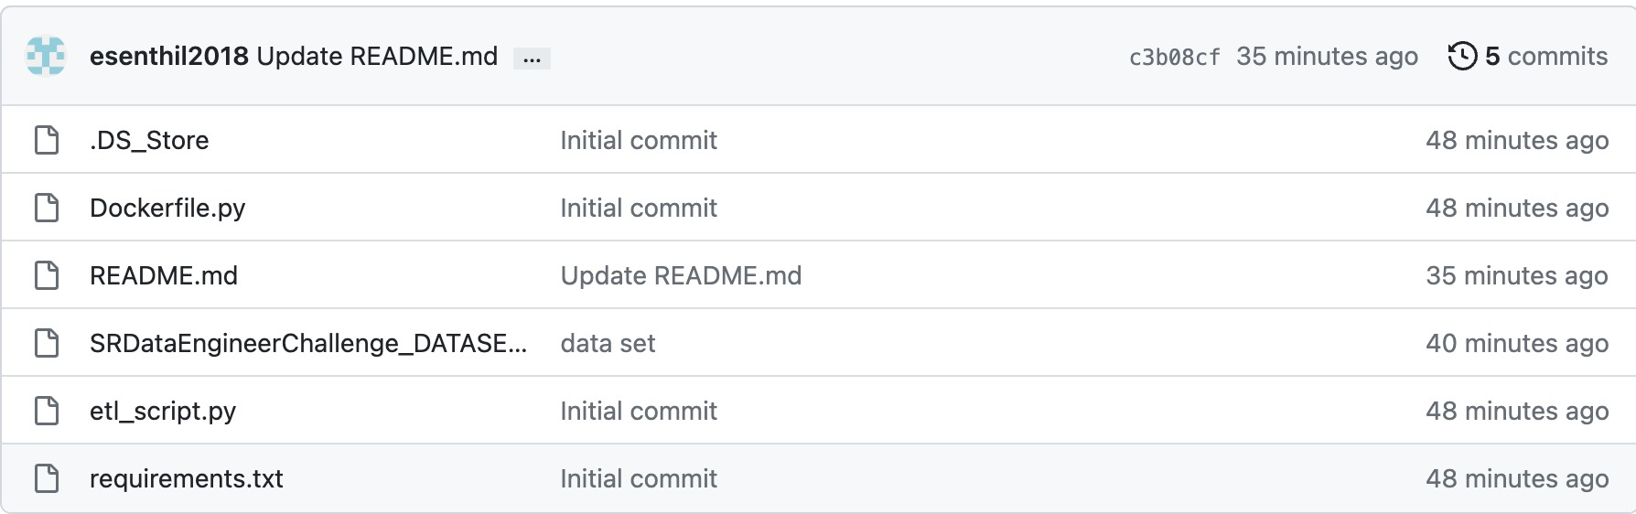
Github Repository Link
https://github.com/esenthil2018/Data_Engineering_2

Slide 54
Section:3-ML API
On a cloud (AWS, Azure, GCP) or local environment (docker, kubernetes), deploy an ML model (ex. MNIST: https://paperswithcode.com/dataset/mnist, Fashion MNIST: https://github.com/zalandoresearch/fashion-mnist, or other) as an API endpoint. Please provide reproducible code with documentation for both deployment and usage.

Slide 55
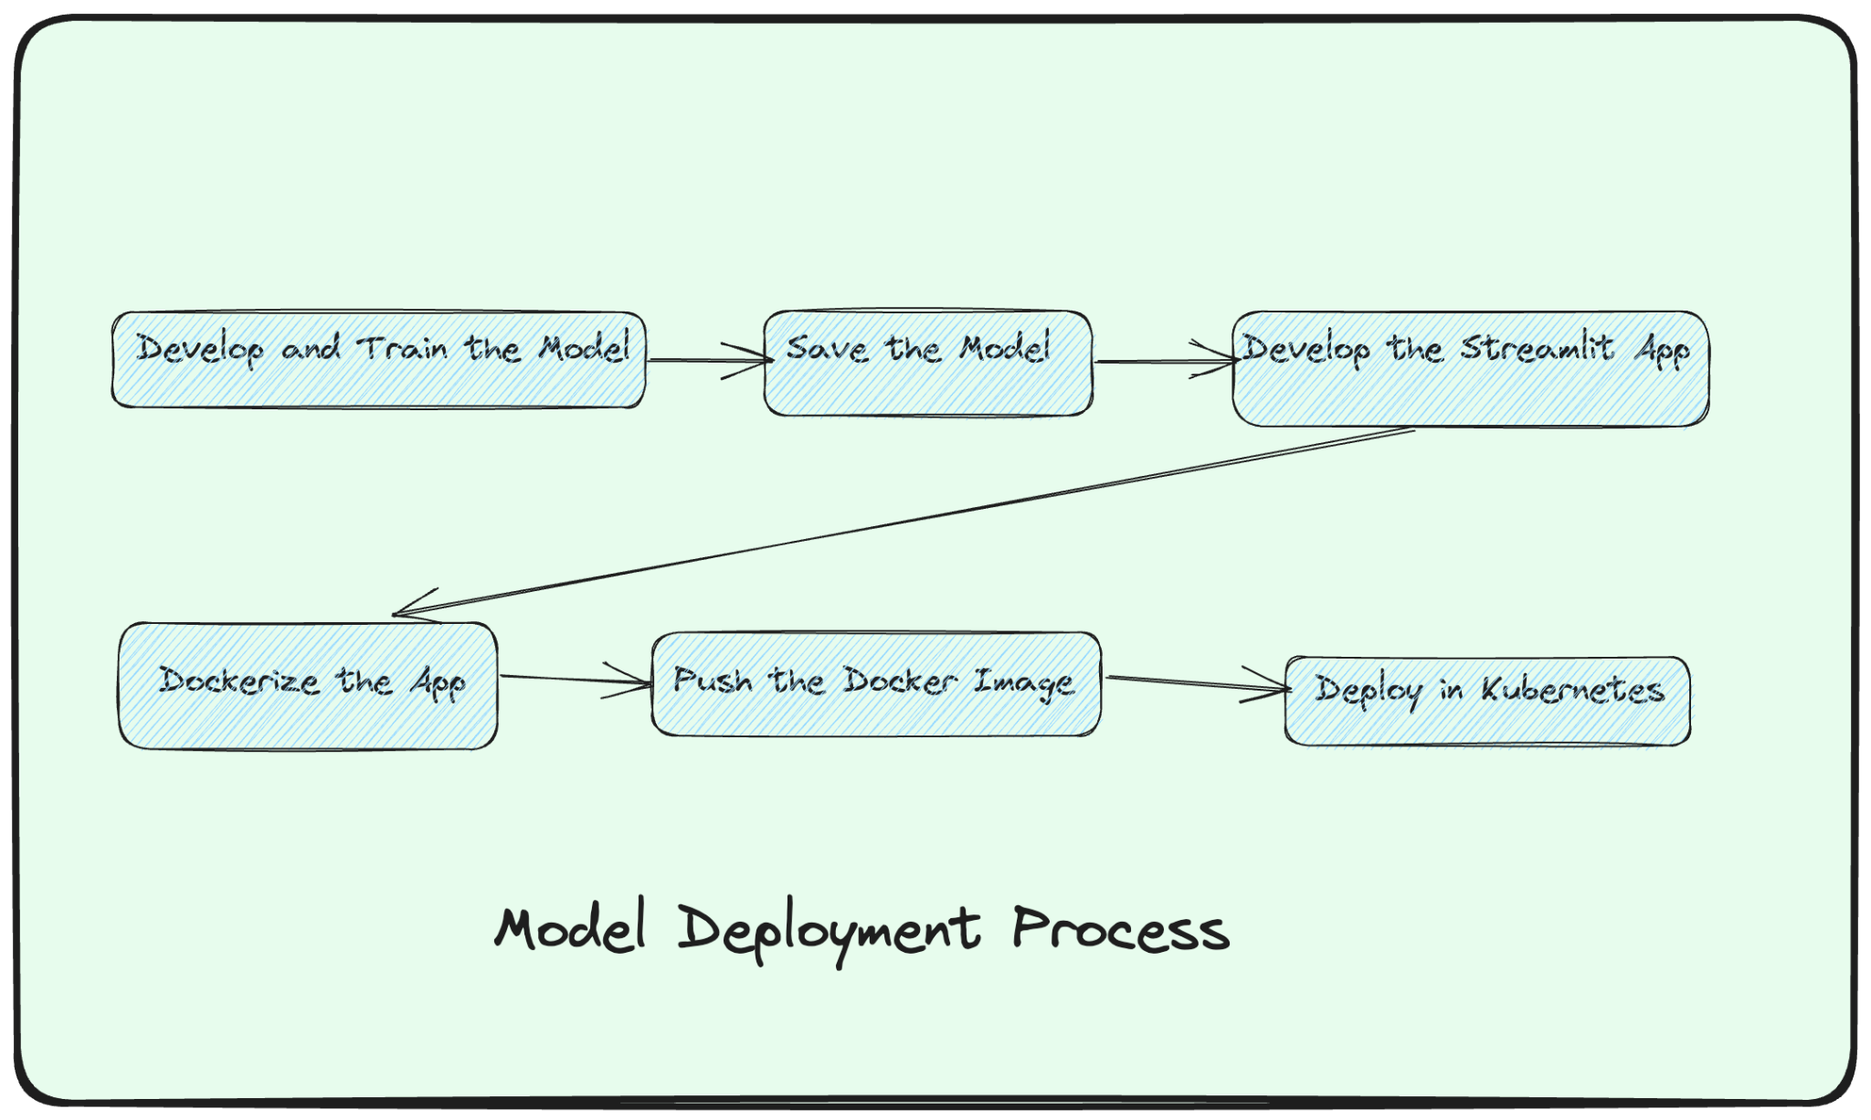

Slide 56
Environment
Step 1: Set Up the Environment
gcloud CLI tool installed: https://cloud.google.com/sdk/gcloud
kubectl installed: https://kubernetes.io/docs/tasks/tools/
A Google Cloud account and a GKE cluster running.

Slide 57
Libraries
# For deep learning model creation and training
tensorflow
# For web application framework
streamlit
# For image handling in the Streamlit app
PILLOW
# For numerical operations (used indirectly by TensorFlow and Streamlit)
numpy
# For Google Cloud SDK operations
google-cloud-sdk

Slide 58
Step:1-Train and Save the MNIST Model
Load the MNIST dataset.
Pre-process and normalize the data.
Construct a neural network with specific layers and activation functions.
Compile the model specifying the optimizer, loss function, and evaluation metrics.
Train the model using the training dataset.
Save the trained model to a .h5 file for future use.

Slide 59
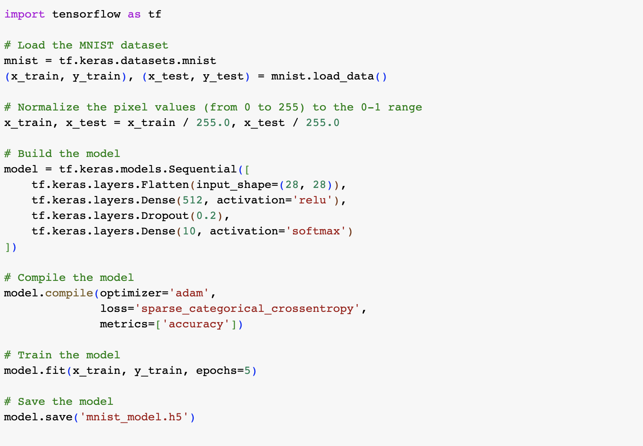
Step:1-Train and Save the MNIST Model

Slide 60
Step:2-Create the Streamlit App
Load the pre-trained MNIST model.
Define a function to process uploaded images and make predictions using the model.
Design the Streamlit interface to allow image uploads.
Display the uploaded image and show the prediction results.

Slide 61
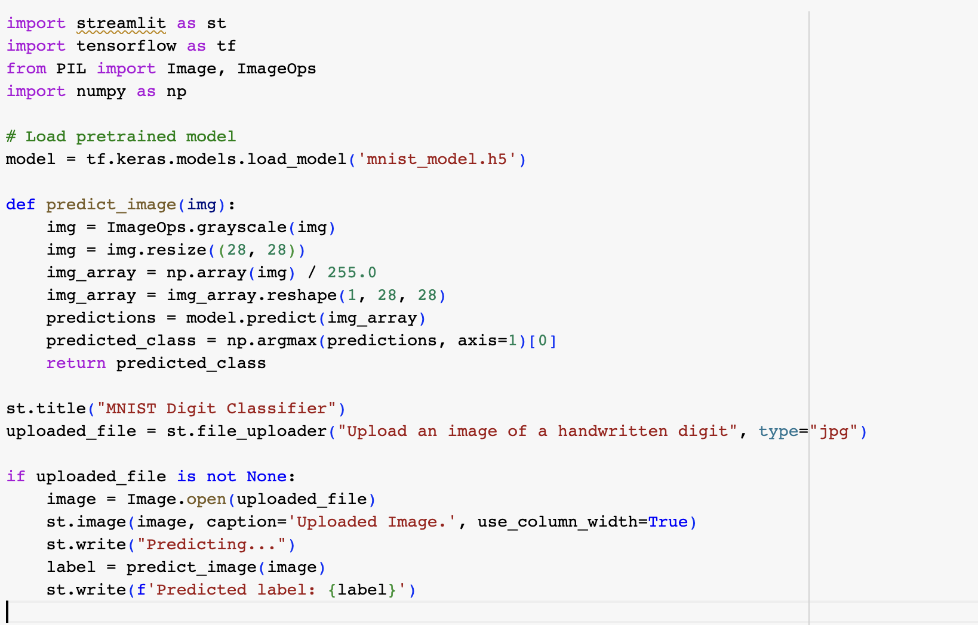
Step:2-Create the Streamlit App

Slide 62
Step:3-Dockerize the App
Create a Dockerfile specifying the base image, working directory, dependencies, and the command to run the Streamlit app.
Build the Docker image.
Push the Docker image to a container registry (e.g., Google Container Registry).

Slide 63
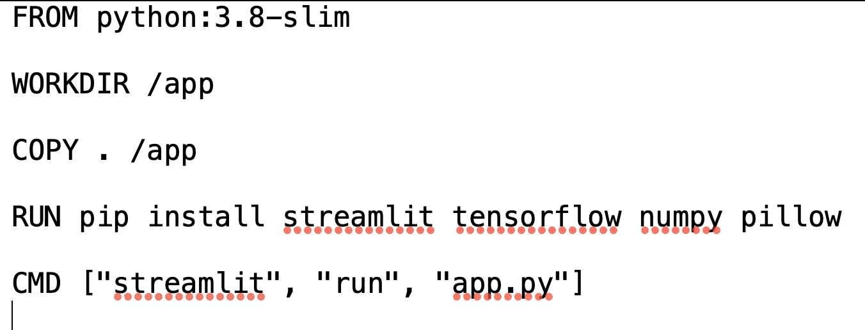
Step:3-Dockerize the App

Slide 64
Step3: Create the Image and Push to the Registry
# Build the docker image
docker build -t gcr.io/mlops-project-8934/mnist-streamlit:v1 .
gcloud auth configure-docker
#Push the docker image to the GCP registry
docker push gcr.io/mlops-project-8934/mnist-streamlit:v1

Slide 65
Step4: Deploy on GKE(Google Kubernetes Engine)
Define a Kubernetes Deployment configuration to specify how the app should be deployed on GKE.
Define a Kubernetes Service configuration to expose the app to the internet.
Use kubectl commands to apply these configurations and deploy the app on GKE.
Retrieve the external IP to access the deployed Streamlit app.

Slide 66
GKE Deployment Steps
Set Up GKE Cluster:
Install the Google Cloud SDK.
Authenticate your command line to GCP
gcloud auth login
Set your GCP project:
gcloud config set project YOUR_PROJECT_ID
Create a GKE cluster:
gcloud container clusters create YOUR_CLUSTER_NAME --zone YOUR_ZONE --num-nodes=1 --machine-type=e2-small

Slide 67
GKE Deployment Steps-Continued
4.Configure kubectl to use the newly created cluster:
gcloud container clusters get-credentials YOUR_CLUSTER_NAME --zone YOUR_ZONE
5.Push Docker Image to Google Container Registry (GCR):
docker tag YOUR_DOCKER_IMAGE gcr.io/YOUR_PROJECT_ID/YOUR_IMAGE_NAME:YOUR_TAG
6.Push the Docker image:
docker push gcr.io/YOUR_PROJECT_ID/YOUR_IMAGE_NAME:YOUR_TAG

Slide 68
GKE-Deployment Steps-Continued
Deployment.yaml:
kubectl apply -f deployment.yaml
Apply the Service:
kubectl apply -f service.yaml
View Running Pods:
kubectl get pods
View active services:
kubectl get svc

Slide 69
GKE Deployment Steps-Continued
Describe a specific pod
kubectl describe pod POD_NAME
View logs for a specific pod:
kubectl logs POD_NAME
Delete a service or deployment:
kubectl delete -f FILE_NAME.yaml
Accessing Your App:
kubectl get svc SERVICE_NAME

Slide 70
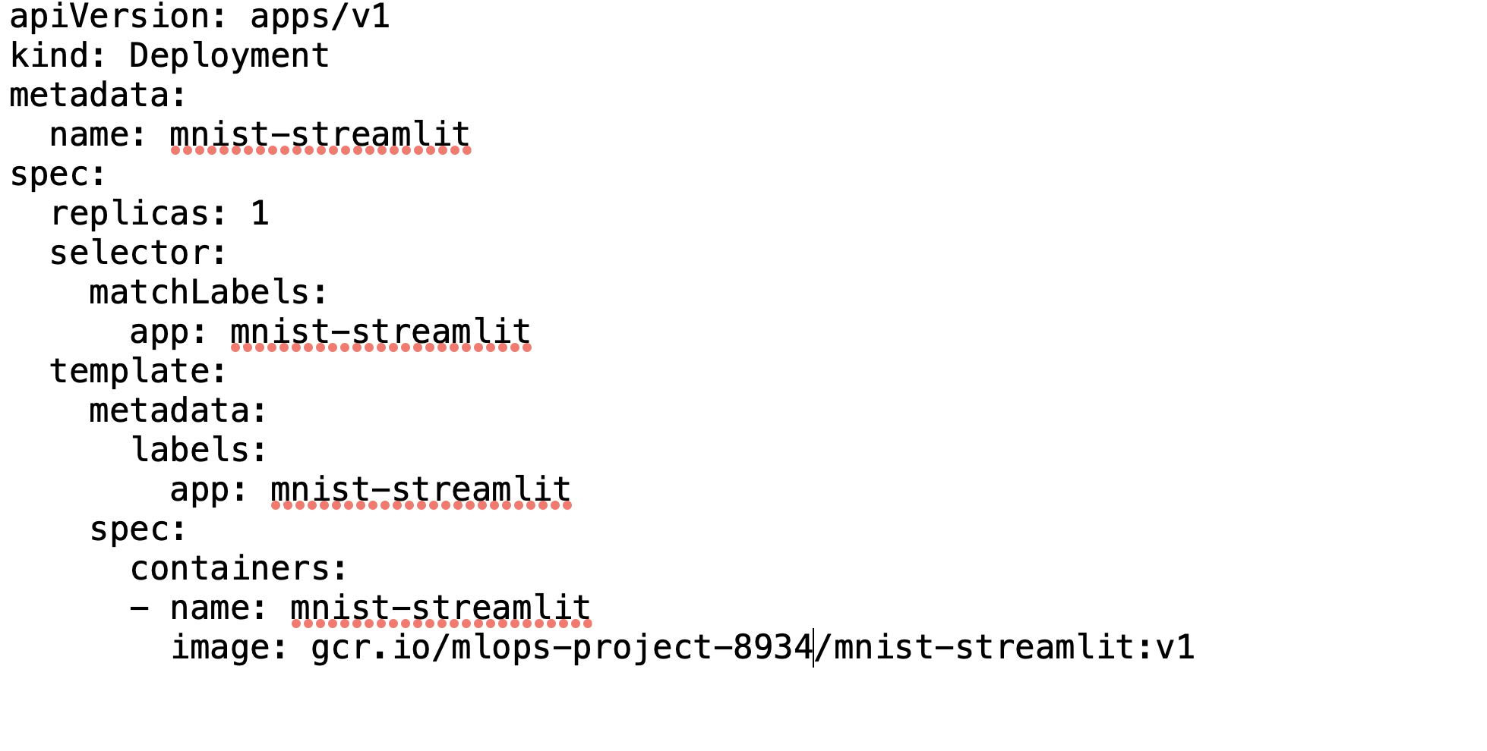
Deployment Configuration (deployment.yaml):

Slide 71
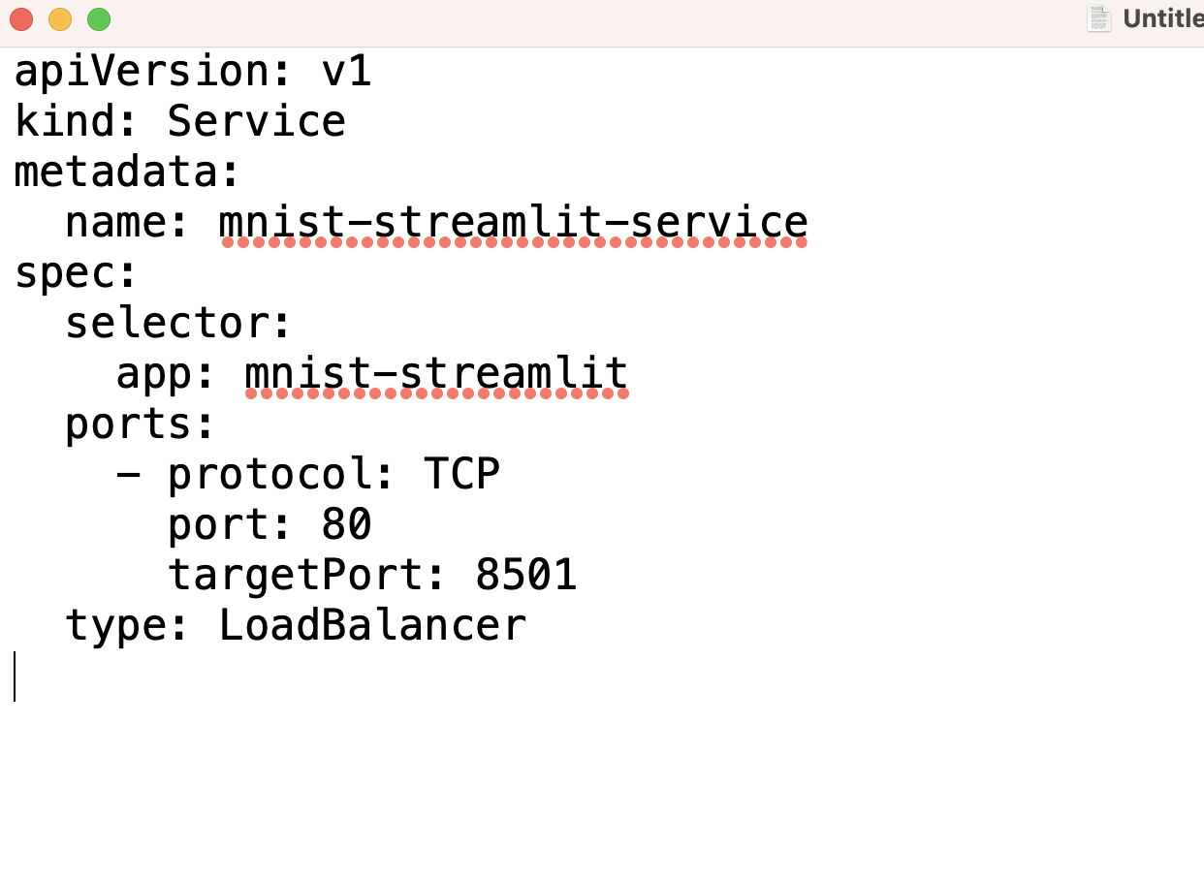
Service Configuration (service.yaml):

Slide 72
Deployment in GKE
Using kubectl:
Apply the deployment file, Service File and get the endpoint
kubectl apply -f deployment.yaml
kubectl apply -f service.yaml
kubectl get svc mnist-streamlit-service

Slide 73
Step5: Share and Replicate
Bundle all files, scripts, and configurations into a GitHub repository.
Share the repository link and instructions with colleagues or others to replicate the deployment process.

Slide 74
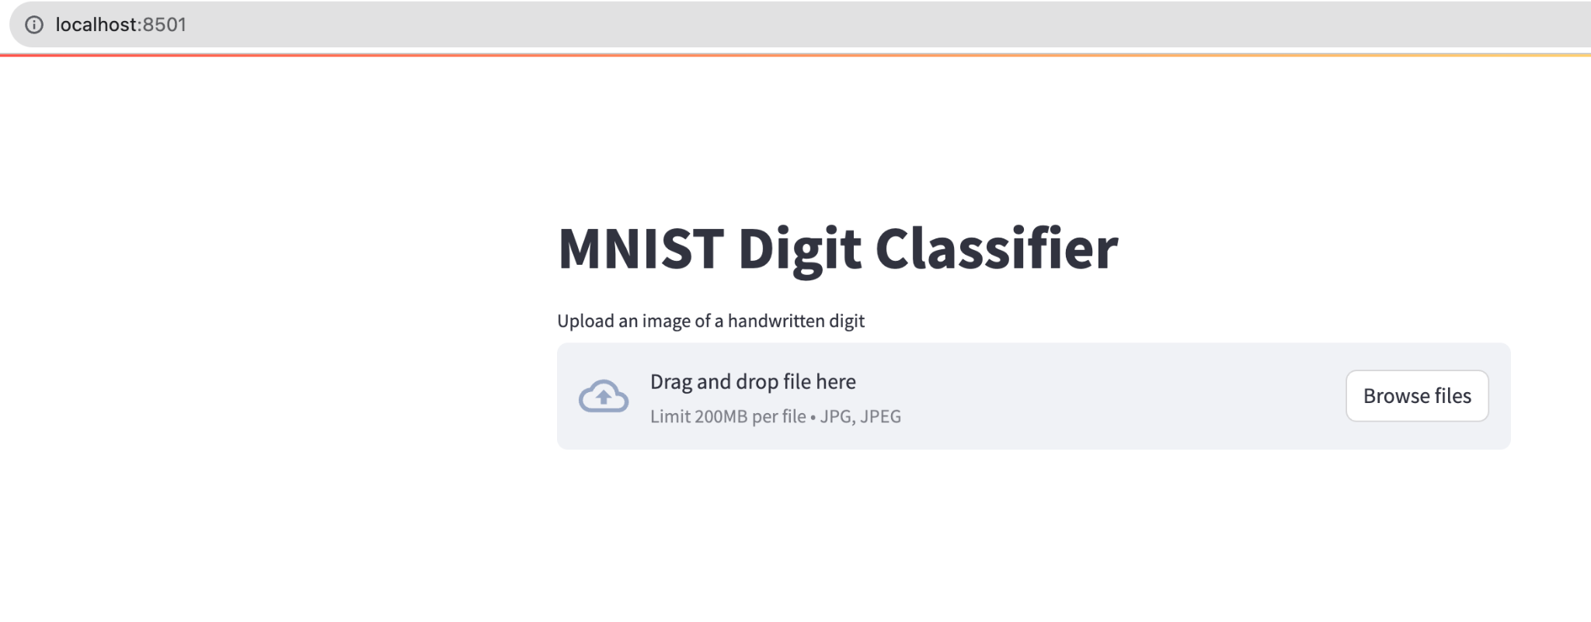

Slide 75
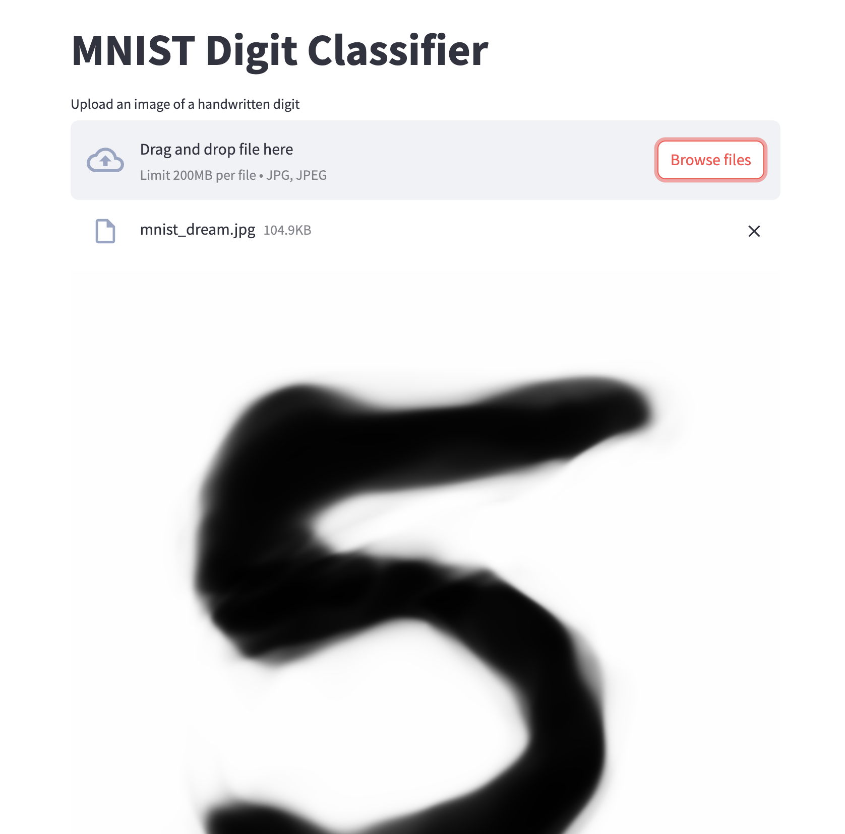

Slide 76
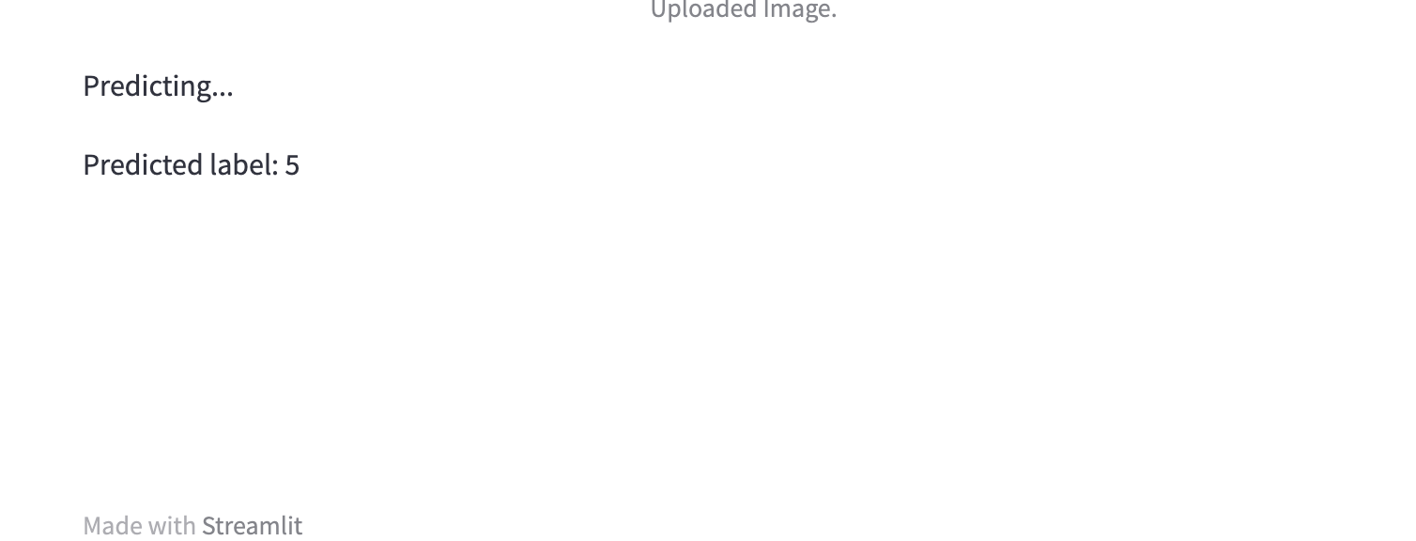
Streamlit App

Slide 77
Github Files-Explanation
train_model.py:
The script that defines, trains, and saves the MNIST model.
app.py:
The Streamlit app script. This will load the trained model, allow users to upload images, and display model predictions.
mnist_model.h5 (optional):
The trained model file. This can be large. If you include training instructions, you might decide to leave this out and have users train their own model.
Dockerfile:
Instructions for building your Docker container, which includes the Streamlit app and all its dependencies.

Slide 78
Github Files-Explanation
requirements.txt:
List of Python libraries required for the project.
deployment.yaml:
Kubernetes configuration for deploying your app on Google Kubernetes Engine (GKE).
service.yaml:
Kubernetes service configuration to expose your deployed app to the internet.
.gitignore:
A file to specify which files or directories should be ignored by Git.

Slide 79
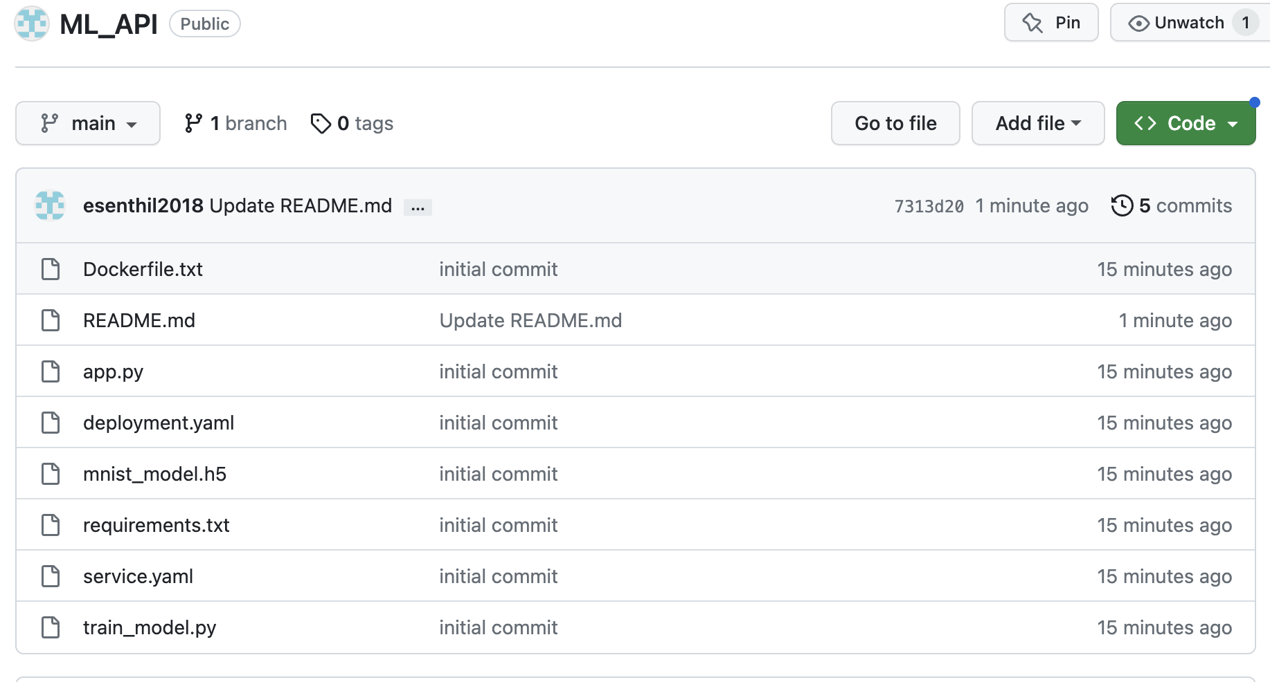
https://github.com/esenthil2018/ML_API

Slide 80
Replicate:1
Clone the Repository:
git clone https://github.com/esenthil2018/ML_API.git
cd ML_API
Set Up a Virtual Environment:
python -m venv venv
source venv/bin/activate # On Windows, use `venv\Scripts\activate`
Install the Required Packages:
pip install -r requirements.txt

Slide 81
Few of My Articles:
Medium:https://medium.com/@esenthil
MLOps End-To-End Machine Learning Pipeline-CICD
https://medium.com/analytics-vidhya/mlops-end-to-end-machine-learning-pipeline-cicd-1a7907698a8e?sk=0e776f6c255989997ee8ff966067b70f
LineaPy Data Science Workflow In Just Two Lines: MLOps Made Easy
https://towardsdatascience.com/lineapy-data-science-workflow-in-just-two-lines-mlops-made-easy-679f36ac63bd?sk=78a8fa6cf59180eb25177f64ee87d50e
MLOps: Mastering Machine Learning Deployment: An Intro to Docker, Kubernetes, Helm, and Modern Web Frameworks-End To End Project
https://medium.com/gitconnected/mlops-mastering-machine-learning-deployment-an-intro-to-docker-kubernetes-helm-and-modern-web-b14dd140a9bf

Slide 82
Conclusion
I'd like to sincerely thank the Deloitte team for providing me with this invaluable opportunity. It's been both challenging and rewarding to delve into this case study.
The process reinforced my desire to be a part of Deloitte. I am eager to contribute, learn, and grow with such a dynamic team.
I'm open to any questions and feedback. Looking forward to our continued discussions!

Slide 83
Thank You!!

